Slide 1





Supervised & Unsupervised Encoding Schemes of Binary Variables for Prediction Performance Enhancement
Institute of Industrial Engineering, NTU
Yun-Hao Yang, Jakey Blue
Notes:
各位口試委員、教授、同學們好，我是台大工業工程研究所的研究生 楊雲皓
今天很開心能與各位，分享我與藍俊宏老師的研究題目－是乙種針對二元資料的編碼框架
目的在於壓縮特徵資訊、同時提升資料的分類表現

Slide 2

Overview
Motivation
Methodology
Case Study
Conclusion & Future Work
Notes:
在接下來的半小時中
我會先簡述所遭遇的問題，與本研究的動機
並介紹我們所發展的編碼方法
接著，於案例分析當中，嘗試以不同的資料集，來驗證本方法的可行性
最後，總結研究結果，與未來發展的方向

Slide 3
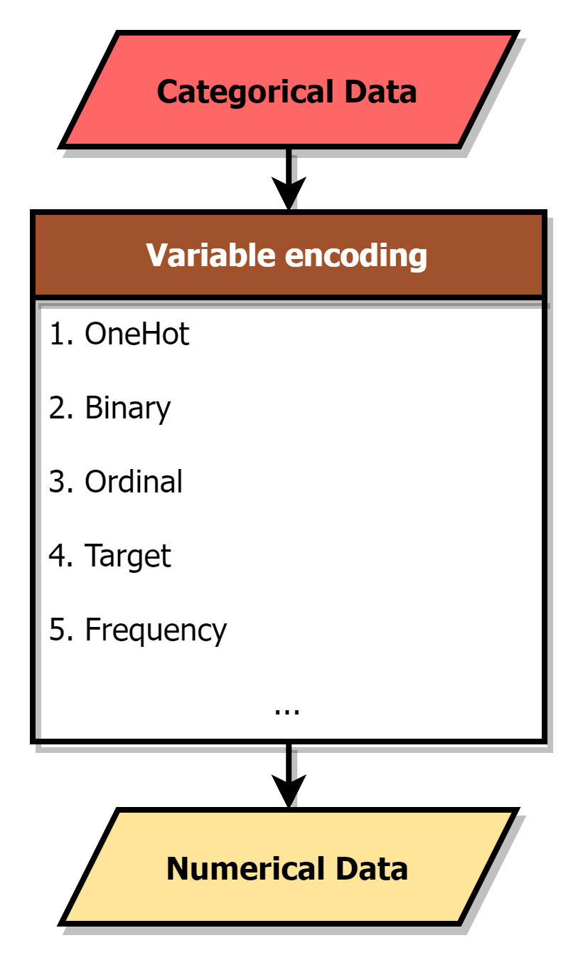
Motivation
Shape
■
▲
●
Variable Encoding
Categorical |  | Numerical
City |  | Ordinal | Binary |  | OneHot |  |  |  | Frequency
Taipei
 |  | 0 | 0 | 0 | 0 | 0 | 0 | 1 | 0.2
New York
 |  | 1 | 0 | 1 | 0 | 0 | 1 | 0 | 0.2
London
 |  | 2 | 1 | 0 | 0 | 1 | 0 | 0 | 0.2
Tokyo
 |  | 3 | 1 | 1 | 1 | 0 | 0 | 0 | 0.2
Tokyo
 |  | 3 | 1 | 1 | 1 | 0 | 0 | 0 | 0.4
ENCODER
■ | ▲ | ●
0 | 0 | 1
0 | 1 | 0
1 | 0 | 0
Notes:
當在訓練，機器學習模型時，
可以發現，大多數模型，通常無法處理資料當中，由字串組成的類別特徵
除非，將這些特徵改以數值的型別呈現

Slide 4
Motivation
Variable Encoding
Categorical |  | Numerical
City |  | Ordinal | Binary |  | OneHot |  |  |  | Frequency
Taipei
 |  | 0 | 0 | 0 | 0 | 0 | 0 | 1 | 0.2
New York
 |  | 1 | 0 | 1 | 0 | 0 | 1 | 0 | 0.2
London
 |  | 2 | 1 | 0 | 0 | 1 | 0 | 0 | 0.2
Tokyo
 |  | 3 | 1 | 1 | 1 | 0 | 0 | 0 | 0.2
Tokyo
 |  | 3 | 1 | 1 | 1 | 0 | 0 | 0 | 0.4
Notes:
而為此，便須透過變數編碼，
在資料預處理的步驟中，協助轉換類別特徵，成為數值型別
目前已有相當多，不同的編碼方法被提出
像是耳熟能詳的Onehot 編碼, Oridinal 編碼 等

Slide 5
Motivation
Variable Encoding
Categorical |  | Numerical
City |  | Ordinal | Binary |  | OneHot |  |  |  | Frequency
Taipei
 |  | 0 | 0 | 0 | 0 | 0 | 0 | 1 | 0.2
New York
 |  | 1 | 0 | 1 | 0 | 0 | 1 | 0 | 0.2
London
 |  | 2 | 1 | 0 | 0 | 1 | 0 | 0 | 0.2
Tokyo
 |  | 3 | 1 | 1 | 1 | 0 | 0 | 0 | 0.2
Tokyo
 |  | 3 | 1 | 1 | 1 | 0 | 0 | 0 | 0.4
Notes:
然而不同編碼方式，轉換出的數值資料，也各不相同
其中，OneHot 編碼可以說是最為常見、且被廣泛使用的編碼方式了，
主要因為其簡單，且有效的特性
它會為類別特徵當中的各個種類，產生新的虛擬變數，並轉變資料為二元型別

Slide 6
Motivation
Categorical | Animal
 | Cow
 | Tuna
 | ⁝
 | Frog
Binary | Tuna | Cat | Frog | Cod | Goat | Dog | … | Cow
 | 0 | 0 | 0 | 0 | 0 | 0 |  | 1
 | 1 | 0 | 0 | 0 | 0 | 0 |  | 0
 | ⁝ | ⁝ | ⁝ | ⁝ | ⁝ | ⁝ |  | ⁝
 | 0 | 0 | 1 | 0 | 0 | 0 |  | 1
OneHot Encoding
Notes:
但是，onehot 編碼也有缺陷，
他的特徵總數，將隨著類別中，的種類而變化

Slide 7
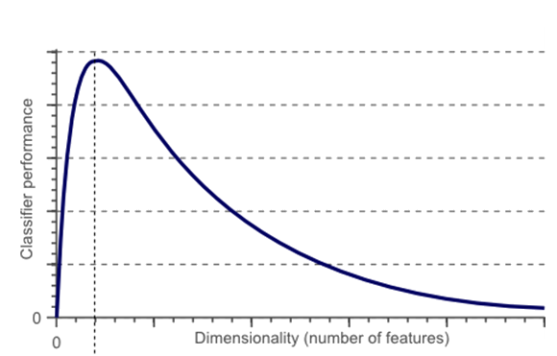
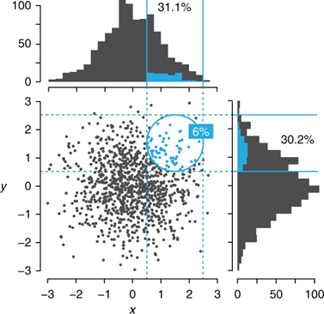
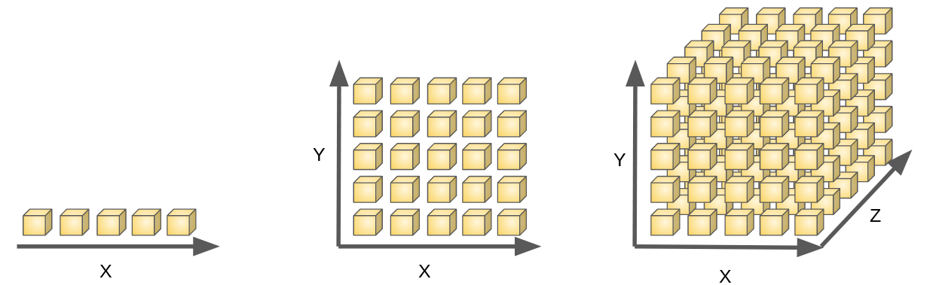
Motivation
Categorical | Animal
 | Cow
 | Tuna
 | ⁝
 | Frog
Binary | Tuna | Cat | Frog | Cod | Goat | Dog | … | Cow
 | 0 | 0 | 0 | 0 | 0 | 0 |  | 1
 | 1 | 0 | 0 | 0 | 0 | 0 |  | 0
 | ⁝ | ⁝ | ⁝ | ⁝ | ⁝ | ⁝ |  | ⁝
 | 0 | 0 | 1 | 0 | 0 | 0 |  | 1
OneHot Encoding
Notes:
當類別特徵中，的種類過多時，OneHot編碼將會大幅度的增加特徵總數
資料也提升至了，更高的維度
但，這樣高維度的資料，將有著多重共線性、並行性等問題
甚至，難以有效計算樣本間的歐式距離
最終，使模型無法對樣本作出有效歸納，導致表現的下滑

Slide 8
Motivation
Categorical | Animal | Size | Color
 | Cow | Big | White
 | Tuna | Med | Black
 | ⁝ | ⁝ | ⁝
 | Frog | Tiny | Green
Other Encoding
Numerical | Animal | Size | Color
 | 10 | 4 | 7
 | 2 | 3 | 6
 | ⁝ | ⁝ | ⁝
 | 7 | 1 | 3
One Hot
Binary | Animal |  |  |  |  |  |  |  | Size |  |  |  | Color
 | Tuna | Cat | Frog | Cod | Goat | Dog | Toad | Cow | Large | Mid | Small | Tiny | White | Black | Red | Blue | Green | Gray
 | 0 | 0 | 0 | 0 | 0 | 0 | 0 | 1 | 1 | 0 | 0 | 0 | 1 | 0 | 0 | 0 | 0 | 0
 | 1 | 0 | 0 | 0 | 0 | 0 | 0 | 0 | 0 | 1 | 0 | 0 | 0 | 1 | 0 | 0 | 0 | 0
 | ⁝ | ⁝ | ⁝ | ⁝ | ⁝ | ⁝ | ⁝ | ⁝ | ⁝ | ⁝ | ⁝ | ⁝ | ⁝ | ⁝ | ⁝ | ⁝ | ⁝ | ⁝
 | 0 | 0 | 1 | 0 | 0 | 0 | 0 | 1 | 0 | 0 | 0 | 1 | 0 | 0 | 0 | 0 | 1 | 0
Notes:
於是，當遭遇多種類的，類別特徵時，
最好，改用其他的編碼方式，像是ordinal, target 編碼
它們，並不會造成特徵個數的增加，如此一來，便能避免維度災難的發生
在圖中可以看到，只有onehot, binary 編碼，將類別資料，轉變為二元型別
而，其餘的編碼方式，則會將類別資料，轉變為整數、或是小數的型別

Slide 9
Motivation
Categorical | Animal | Size | Color
 | Cow | Big | White
 | Tuna | Med | Black
 | ⁝ | ⁝ | ⁝
 | Frog | Tiny | Green
Other Encoding
Numerical | Animal | Size | Color
 | 10 | 4 | 7
 | 2 | 3 | 6
 | ⁝ | ⁝ | ⁝
 | 7 | 1 | 3
Binary
 | Tuna | Cat | Frog | Cod | Goat | Dog | Toad | Cow | Large | Mid | Small | Tiny | White | Black | Red | Blue | Green | Gray
 | 0 | 0 | 0 | 0 | 0 | 0 | 0 | 1 | 1 | 0 | 0 | 0 | 1 | 0 | 0 | 0 | 0 | 0
 | 1 | 0 | 0 | 0 | 0 | 0 | 0 | 0 | 0 | 1 | 0 | 0 | 0 | 1 | 0 | 0 | 0 | 0
 | ⁝ | ⁝ | ⁝ | ⁝ | ⁝ | ⁝ | ⁝ | ⁝ | ⁝ | ⁝ | ⁝ | ⁝ | ⁝ | ⁝ | ⁝ | ⁝ | ⁝ | ⁝
 | 0 | 0 | 1 | 0 | 0 | 0 | 0 | 1 | 0 | 0 | 0 | 1 | 0 | 0 | 0 | 0 | 1 | 0
Notes:
但，如果今天的，第一手資料，就是高維度的，二元資料呢？
目前仍缺乏，將二元資料，轉換為數值資料，的編碼方式

Slide 10


Motivation
Numerical | Animal | Size | Color
 | 10 | 4 | 7
 | 2 | 3 | 6
 | ⁝ | ⁝ | ⁝
 | 7 | 1 | 3
Binary | Tuna | Cat | Frog | Cod | Goat | Dog | Toad | Cow | Large | Mid | Small | Tiny | White | Black | Red | Blue | Green | Gray
 | 0 | 0 | 0 | 0 | 0 | 0 | 0 | 1 | 1 | 0 | 0 | 0 | 1 | 0 | 0 | 0 | 0 | 0
 | 1 | 0 | 0 | 0 | 0 | 0 | 0 | 0 | 0 | 1 | 0 | 0 | 0 | 1 | 0 | 0 | 0 | 0
 | ⁝ | ⁝ | ⁝ | ⁝ | ⁝ | ⁝ | ⁝ | ⁝ | ⁝ | ⁝ | ⁝ | ⁝ | ⁝ | ⁝ | ⁝ | ⁝ | ⁝ | ⁝
 | 0 | 0 | 1 | 0 | 0 | 0 | 0 | 1 | 0 | 0 | 0 | 1 | 0 | 0 | 0 | 0 | 1 | 0
Notes:
如何發展，對二元資料的編碼方式，以協助高維度二元資料，轉換為整數型別
即是我們的研究主題
希望，能在降低維度的同時，維持模型，對於資料分類、或是回歸任務中的表現

Slide 11
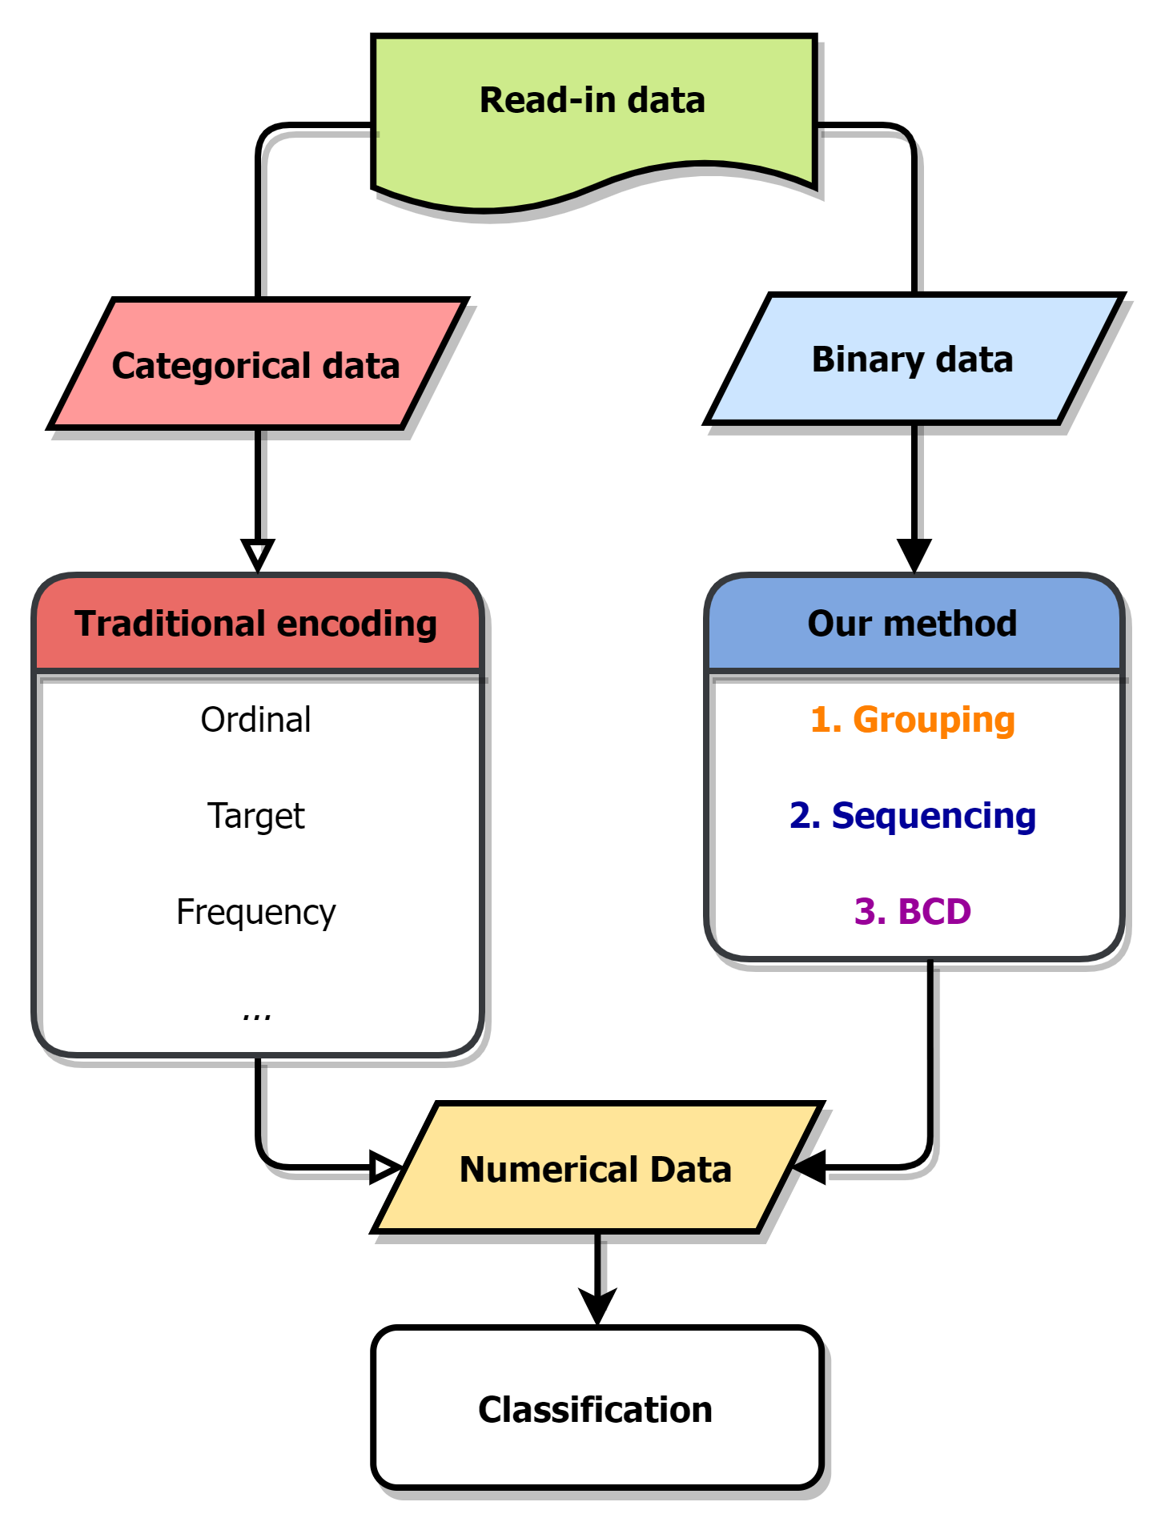
Methodology
Col 6 | Col 2 | Col 5 | Col 4 | Col 1 | Col 3
0 | 1 | 0 | 1 | 1 | 0
0 | 0 | 1 | 1 | 1 | 0
⁝ | ⁝ | ⁝ | ⁝ | ⁝ | ⁝
1 | 0 | 1 | 0 | 0 | 1
Notes:
相比於，傳統變數編碼
我們，則設法開發，針對二元資料的編碼方式

Slide 12
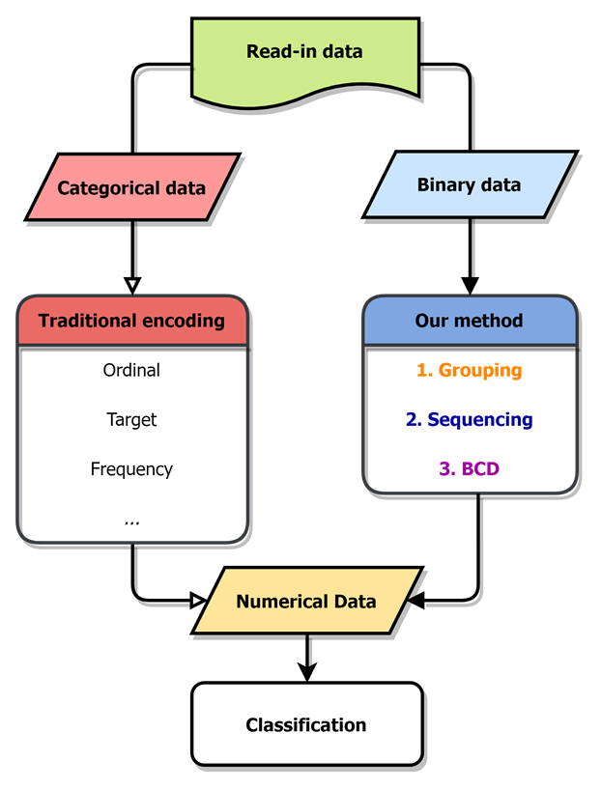
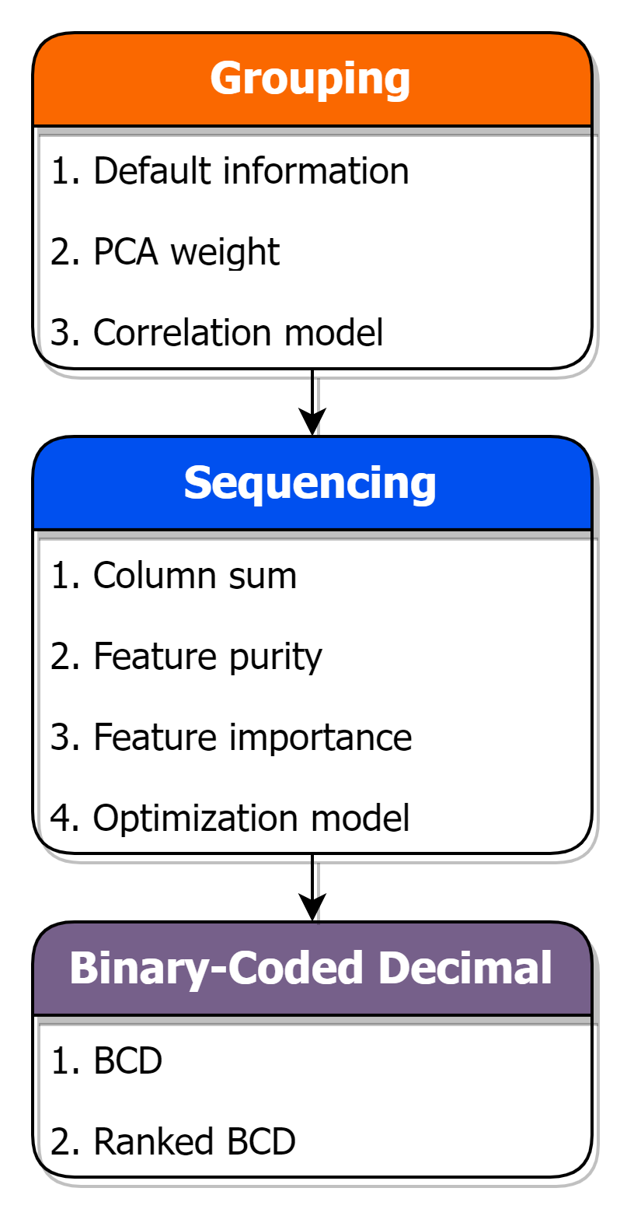
Methodology
Notes:
本研究提出的方式，是依序，透過群組、排序
以及Binary-coded decimal，簡稱BCD碼的方式
便能將，高維度二元資料，轉換為特定維度的，數值型別表達

Slide 13
Methodology
Group
Sequence
BCD
Col 1 | Col 2 | Col 3 | Col 4 | Col 5 | Col 6
1 | 1 | 0 | 1 | 0 | 0
1 | 0 | 0 | 1 | 1 | 0
⁝ | ⁝ | ⁝ | ⁝ | ⁝ | ⁝
0 | 0 | 1 | 0 | 1 | 1
In this study, we propose a method of encoding binary data into numerical data. Through grouping, sequencing, and transforming the binary row data with BCD encode.
Grouping similar, correlated features
Sequencing features in each feature group
BCD encode on each feature group
Tiny | Cat | Large | Black | White | Cow
1 | 1 | 0 | 1 | 0 | 0
0 | 0 | 1 | 0 | 1 | 1
⁝ | ⁝ | ⁝ | ⁝ | ⁝ | ⁝
0 | 0 | 1 | 0 | 1 | 1
Notes:
以下將由動畫的方式，簡單帶過整個編碼流程
假設以，此六個二元特徵作為原始資料
可見資料中，分別有2個動物、尺寸、顏色的特徵

Slide 14
Methodology
Group
Sequence
BCD
In this study, we propose a method of encoding binary data into numerical data. Through grouping, sequencing, and transforming the binary row data with BCD encode.
Grouping similar, correlated features
Sequencing features in each feature group
BCD encode on each feature group
Tiny
1
0
⁝
0
Cat
1
0
⁝
0
Large
0
1
⁝
1
Black
1
0
⁝
0
White
0
1
⁝
1
Cow
0
1
⁝
1
Notes:
第一步便是群組，以找出特徵間的關聯關係
將相互關聯、或相似的特徵，規納入同一群組之中

Slide 15
Methodology
Group
Sequence
BCD
In this study, we propose a method of encoding binary data into numerical data. Through grouping, sequencing, and transforming the binary row data with BCD encode.
Grouping similar, correlated features
Sequencing features in each feature group
BCD encode on each feature group
Cat
1
0
⁝
0
Cow
0
1
⁝
1
Black
1
0
⁝
0
White
0
1
⁝
1
Tiny
1
0
⁝
0
Large
0
1
⁝
1
Notes:
第二步為排序，在各群組內部調動特徵順序
此步驟，是為了產生出更具有競爭力、
且能助於分類或回歸任務的數值資料

Slide 16
Methodology
Group
Sequence
BCD
In this study, we propose a method of encoding binary data into numerical data. Through grouping, sequencing, and transforming the binary row data with BCD encode.
Grouping similar, correlated features
Sequencing features in each feature group
BCD encode on each feature group
Cow | Cat | White | Black | Tiny | Large
0 | 1 | 0 | 1 | 1 | 0
1 | 0 | 1 | 0 | 0 | 1
⁝ | ⁝ | ⁝ | ⁝ | ⁝ | ⁝
1 | 0 | 1 | 0 | 0 | 1

Slide 17
Methodology
Group
Sequence
BCD
In this study, we propose a method of encoding binary data into numerical data. Through grouping, sequencing, and transforming the binary row data with BCD encode.
Grouping similar, correlated features
Sequencing features in each feature group
BCD encode on each feature group
Animal | Color | Size
1 | 1 | 2
2 | 2 | 1
⁝ | ⁝ | ⁝
2 | 2 | 1
Notes:
最後一步，則是進行BCD編碼，
將排序過後的複數二元特徵，轉換為數值的形式
經由此三步驟，便完成了整個編碼過程

Slide 18
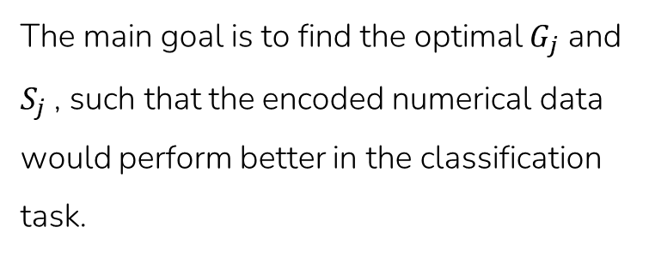
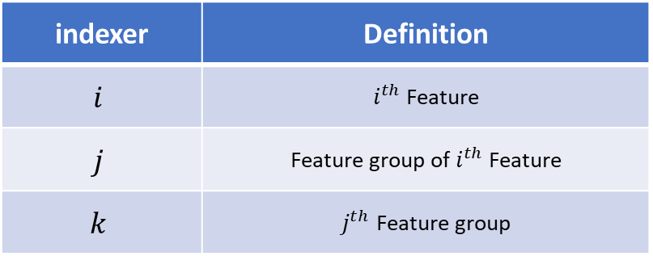
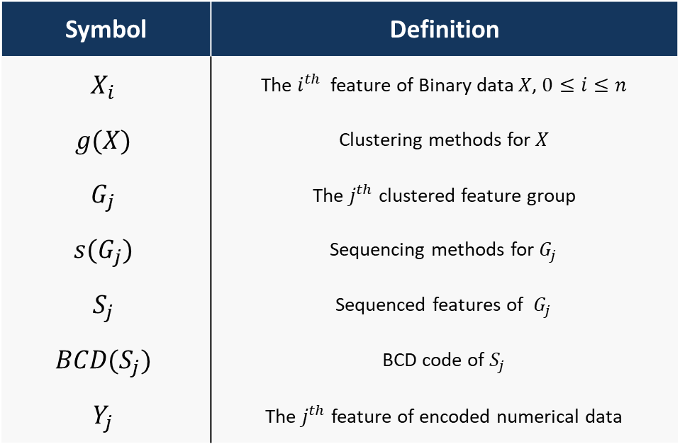
Methodology -problem definition
The main goal is to find the optimal $G_{j}$ and $S_{j}$ , such that the encoded numerical data would perform better in the classification task.
Symbol | Definition
$$X_{i}$$ | The $i^{th}$ feature of Binary data $X$, $0≤i≤n$
$$g(X)$$ | Clustering methods for $X$
$$G_{j}$$ | The $j^{th}$ clustered feature group
$$s(G_{j})$$ | Sequencing methods for $G_{j}$
$$S_{j}$$ | Sequenced features of $G_{j}$
$$BCD(S_{j})$$ | BCD code of $S_{j}$
$$Y_{j}$$ | The $j^{th}$ feature of encoded numerical data
indexer | Definition
$$i$$ | $i^{th}$ Feature
$$j$$ | Feature group of $i^{th}$ Feature
$$k$$ | $j^{th}$ Feature group
Notes:
簡而言之，本研究，著重在於尋找出最佳的群組、以及排序方式
以達到，在縮減資料特徵總數、壓縮資訊時，
也能維持資料在分類，或回歸上的表現

Slide 19
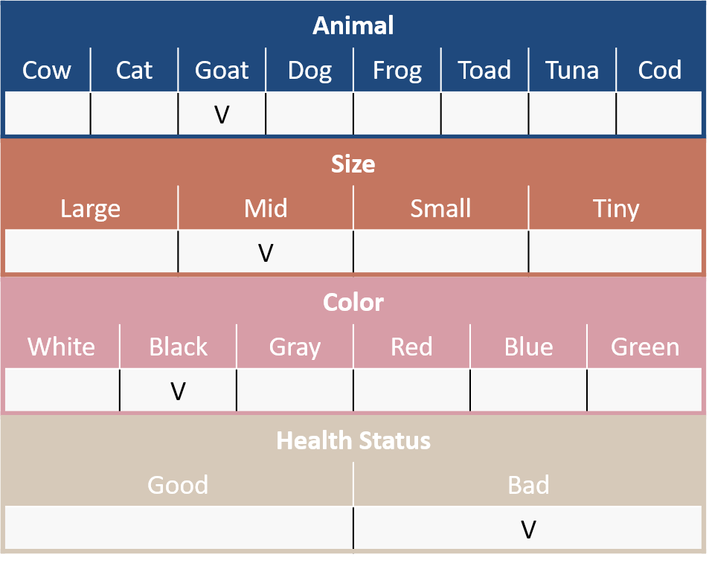
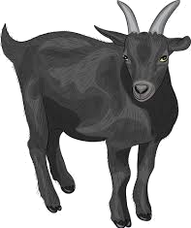



Methodology -An animal health check
Animal
Cow | Cat | Goat | Dog | Frog | Toad | Tuna | Cod
 |  | V
Size
Large | Mid | Small | Tiny
 | V
Color
White | Black | Gray | Red | Blue | Green
 | V
Health Status
Good | Bad
 | V
Notes:
為了便於理解，在此提及個簡單的範例
假設，我們為動物園的管理者，需要對園區中的各式動物，進行健康檢測
檢核表如圖所示，包含了物種、尺寸、顏色以及健康狀態的欄位

Slide 20
Methodology -An animal health check
Binary Data (Total:300 samples, 200 good, 100 bad)
Animal
Cow | Cat | Goat | Dog | Frog | Toad | Tuna | Cod
 |  | V
Size
Large | Mid | Small | Tiny
 | V
Color
White | Black | Gray | Red | Blue | Green
 | V
Health Status
Good | Bad
 | V
Notes:
當在蒐集了300隻，園中動物的資料後，可以得到右方的堆疊直方圖
表示了在各個選項中，被勾選的動物數量，
其中，以紅、藍兩色作為生病、與健康的標示
像是在，尺寸:中等的選項中，便有接近100隻的動物
且這些動物中，大約有一半為健康、另一半為生病
而我們的任務，便是以這18個二元選項作為特徵，來預測動物的健康狀態

Slide 21
Methodology -An animal health check
Binary Data (Total:300 samples, 200 good, 100 bad)
Animal | Cow | Cat | Goat | Dog | Frog | … | Blue | Green
#1 | 0 | 1 | 0 | 0 | 0 | … | 0 | 0
#2 | 1 | 0 | 0 | 0 | 0 | … | 0 | 0
#3 | 0 | 0 | 0 | 0 | 0 | … | 0 | 0
#4 | 0 | 0 | 0 | 0 | 0 | … | 0 | 0
#5 | 0 | 0 | 1 | 0 | 0 | … | 0 | 0
#6 | 0 | 0 | 0 | 0 | 1 | … | 0 | 0
#7 | 0 | 0 | 0 | 0 | 0 | … | 0 | 0
⁝ | ⁝ | ⁝ | ⁝ | ⁝ | ⁝ | ⁝ | ⁝ | ⁝
#300 | 0 | 0 | 0 | 1 | 0 | … | 0 | 0
Animal
Cow | Cat | Goat | Dog | Frog | Toad | Tuna | Cod
 |  | V
Size
Large | Mid | Small | Tiny
 | V
Color
White | Black | Gray | Red | Blue | Green
 | V
Health Status
Good | Bad
 | V
Notes:
也可將直方圖，改為表格的形式
仍同樣代表著，園中動物在這18個選項中，的分佈狀態

Slide 22
Methodology -Grouping
Group
Sequence
BCD
Binary Data (Total:300 sample, 200 good, 100 bad)
First, we try to find and cluster the related binary features.
Default information
PCA weight
Correlation model
K-means
Hierarchical clustering
Block modeling
Notes:
依照我們的方法
首先，將針對這18個二元特徵，進行群組，
除了依照原先的欄位資訊群組之外，
我們已嘗試使用PCA權重、
聚類模型，結合相關係數的方式，來完成群組二元特徵的任務

Slide 23
Methodology -PCA Grouping
Group
Sequence
BCD
No. | PC 1 |  |  | PC 2 |  |  | PC 3
 | Feature | Abs. weight | select | Feature | Abs. weight | select | Feature | Abs. weight | select
1. | Cow | 0.562 | O | Cat | 0.642 | X | Black | 0.047 | X
2. | Cat | 0.486 | O | Cow | 0.496 | X | Goat | 0.035 | X
3. | Large | 0.348 | O | Mid | 0.402 | X | Cat | 0.032 | X
4. | Mid | 0.311 | O | Black | 0.351 | X | Cow | 0.030 | X
5. | White | 0.307 | O | Goat | 0.302 | O | Mid | 0.028 | X
6. | Black | 0.202 | O | Dog | 0.229 | O | Gray | 0.023 | X
7. | Small | 0.187 | X | Large | 0.199 | X | White | 0.021 | X
8. | Goat | 0.153 | X | Frog | 0.183 | O | Dog | 0.020 | X
9. | Cod | 0.101 | X | Small | 0.152 | O | Large | 0.018 | X
10. | Tuna | 0.091 | X | Gray | 0.132 | O | Frog | 0.016 | X
11. | Dog | 0.074 | X | White | 0.105 | X | Small | 0.014 | X
12. | Gray | 0.060 | X | Red | 0.008 | O | Toad | 0.014 | O
13. | Frog | 0.056 | X | Frog | 0.008 | X | Tuna | 0.012 | O
14. | Toad | 0.032 | X | Red | 0.007 | X | Cod | 0.007 | O
15. | Red | 0.029 | X | Toad | 0.005 | X | Red | 0.005 | X
16. | Tiny | 0.023 | X | Green | 0.001 | X | Tiny | 0.002 | O
17. | Green | 0.015 | X | Tiny | 0.001 | X | Blue | 0.001 | O
18. | Blue | 0.009 | X | Blue | 0.001 | X | Green | 0.001 | O
Notes:
首先是介紹的是，針對PCA權重 的群組方式
透過主成分，依序列舉出權重絕對值，
依照順序選取，前六個特徵進入同一群組中
若特徵已被前方主成分選取，則跳過並依序選則下一個

Slide 24
Methodology -PCA Grouping
Group
Sequence
BCD
No. | PC 1 |  |  | PC 2 |  |  | PC 3
 | Feature | Abs. weight | select | Feature | Abs. weight | select | Feature | Abs. weight | select
1. | Cow | 0.562 | O | Cat | 0.642 | X | Black | 0.047 | X
2. | Cat | 0.486 | O | Cow | 0.496 | X | Goat | 0.035 | X
3. | Large | 0.348 | O | Mid | 0.402 | X | Cat | 0.032 | X
4. | Mid | 0.311 | O | Black | 0.351 | X | Cow | 0.030 | X
5. | White | 0.307 | O | Goat | 0.302 | O | Mid | 0.028 | X
6. | Black | 0.202 | O | Dog | 0.229 | O | Gray | 0.023 | X
7. | Small | 0.187 | X | Large | 0.199 | X | White | 0.021 | X
8. | Goat | 0.153 | X | Frog | 0.183 | O | Dog | 0.020 | X
9. | Cod | 0.101 | X | Small | 0.152 | O | Large | 0.018 | X
10. | Tuna | 0.091 | X | Gray | 0.132 | O | Frog | 0.016 | X
11. | Dog | 0.074 | X | White | 0.105 | X | Small | 0.014 | X
12. | Gray | 0.060 | X | Red | 0.008 | O | Toad | 0.014 | O
13. | Frog | 0.056 | X | Frog | 0.008 | X | Tuna | 0.012 | O
14. | Toad | 0.032 | X | Red | 0.007 | X | Cod | 0.007 | O
15. | Red | 0.029 | X | Toad | 0.005 | X | Red | 0.005 | X
16. | Tiny | 0.023 | X | Green | 0.001 | X | Tiny | 0.002 | O
17. | Green | 0.015 | X | Tiny | 0.001 | X | Blue | 0.001 | O
18. | Blue | 0.009 | X | Blue | 0.001 | X | Green | 0.001 | O
Notes:
透過主成分分析，可將最能解釋整體資料變異、最具資訊的二元特徵，劃分入相同群組之中
反之，最無法解釋變異的特徵們，也會被劃分入同一群組內，
有點類似於能力分班，使強者群與弱者群之間，相互隔離

Slide 25
Methodology -Block modeling Grouping
Group
Sequence
BCD
 | Tuna | Cat | Frog | Cod | Goat | Dog | Toad | Cow | Large | Mid | Small | Tiny | White | Black | Red | Blue | Green | Gray
Tuna | 1.0 | 0.2 | 0.2 | 0.8 | 0.2 | 0.2 | 0.8 | 0.2 | 0.1 | 0.1 | 0.1 | 0.3 | 0.0 | 0.0 | 0.0 | 0.5 | 0.5 | 0.0
Cat | 0.2 | 1.0 | 0.2 | 0.2 | 0.2 | 0.2 | 0.2 | 0.8 | 0.3 | 0.3 | 0.1 | 0.1 | 0.2 | 0.2 | 0.0 | 0.0 | 0.0 | 0.0
Frog | 0.2 | 0.2 | 1.0 | 0.2 | 0.8 | 0.8 | 0.2 | 0.2 | 0.1 | 0.1 | 0.3 | 0.1 | 0.0 | 0.0 | 0.3 | 0.0 | 0.0 | 0.3
Cod | 0.8 | 0.2 | 0.2 | 1.0 | 0.2 | 0.2 | 0.8 | 0.8 | 0.1 | 0.1 | 0.1 | 0.3 | 0.0 | 0.0 | 0.0 | 0.3 | 0.3 | 0.0
Goat | 0.2 | 0.2 | 0.8 | 0.2 | 1.0 | 0.8 | 0.2 | 0.2 | 0.1 | 0.1 | 0.3 | 0.1 | 0.0 | 0.0 | 0.3 | 0.0 | 0.0 | 0.3
Dog | 0.2 | 0.2 | 0.8 | 0.2 | 0.8 | 1.0 | 0.2 | 0.2 | 0.1 | 0.1 | 0.3 | 0.1 | 0.0 | 0.0 | 0.3 | 0.0 | 0.0 | 0.3
Toad | 0.8 | 0.2 | 0.2 | 0.8 | 0.2 | 0.2 | 1.0 | 0.2 | 0.1 | 0.1 | 0.1 | 0.3 | 0.0 | 0.0 | 0.0 | 0.3 | 0.0 | 0.0
Cow | 0.2 | 0.8 | 0.2 | 0.8 | 0.2 | 0.2 | 0.2 | 1.0 | 0.3 | 0.3 | 0.1 | 0.1 | 0.3 | 0.3 | 0.0 | 0.0 | 0.0 | 0.0
Large | 0.1 | 0.3 | 0.1 | 0.1 | 0.1 | 0.1 | 0.1 | 0.3 | 1.0 | 0.5 | 0.1 | 0.1 | 0.6 | 0.6 | 0.2 | 0.2 | 0.2 | 0.2
Mid | 0.1 | 0.3 | 0.1 | 0.1 | 0.1 | 0.1 | 0.1 | 0.3 | 0.5 | 1.0 | 0.1 | 0.1 | 0.6 | 0.6 | 0.2 | 0.2 | 0.2 | 0.2
Small | 0.1 | 0.1 | 0.3 | 0.1 | 0.3 | 0.3 | 0.1 | 0.1 | 0.1 | 0.1 | 1.0 | 0.1 | 0.2 | 0.2 | 0.6 | 0.2 | 0.2 | 0.6
Tiny | 0.3 | 0.1 | 0.1 | 0.3 | 0.1 | 0.1 | 0.3 | 0.1 | 0.1 | 0.1 | 0.1 | 1.0 | 0.2 | 0.2 | 0.2 | 0.6 | 0.2 | 0.2
White | 0.0 | 0.2 | 0.0 | 0.0 | 0.0 | 0.0 | 0.0 | 0.3 | 0.6 | 0.6 | 0.2 | 0.2 | 1.0 | 0.8 | 0.4 | 0.4 | 0.4 | 0.4
Black | 0.0 | 0.2 | 0.0 | 0.0 | 0.0 | 0.0 | 0.0 | 0.3 | 0.6 | 0.6 | 0.2 | 0.2 | 0.8 | 1.0 | 0.4 | 0.4 | 0.4 | 0.8
Red | 0.0 | 0.0 | 0.3 | 0.0 | 0.3 | 0.3 | 0.0 | 0.0 | 0.2 | 0.2 | 0.6 | 0.2 | 0.4 | 0.4 | 1.0 | 0.4 | 0.4 | 0.4
Blue | 0.5 | 0.0 | 0.0 | 0.3 | 0.0 | 0.0 | 0.3 | 0.0 | 0.2 | 0.2 | 0.2 | 0.6 | 0.4 | 0.4 | 0.4 | 1.0 | 0.8 | 0.8
Green | 0.5 | 0.0 | 0.0 | 0.3 | 0.0 | 0.0 | 0.0 | 0.0 | 0.2 | 0.2 | 0.2 | 0.2 | 0.4 | 0.4 | 0.4 | 0.8 | 1.0 | 0.4
Gray | 0.0 | 0.0 | 0.3 | 0.0 | 0.3 | 0.3 | 0.0 | 0.0 | 0.2 | 0.2 | 0.6 | 0.2 | 0.4 | 0.8 | 0.4 | 0.8 | 0.4 | 1.0
Notes:
接著介紹的，是以區塊模型，結合相關係數，的群組方式
在計算出特徵間，的相關係數圖後，便嘗試調動特徵順序
使整張相關係數圖，區分出不同的聚類

Slide 26
Methodology -Block modeling Grouping
Group
Sequence
BCD
 | Cow | Cat | Large | Mid | White | Black | Goat | Dog | Frog | Small | Gray | Red | Toad | Tuna | Cod | Tiny | Blue | Green
Cow | 1.0 | 0.8 | 0.3 | 0.3 | 0.5 | 0.5 | 0.2 | 0.2 | 0.2 | 0.1 | 0.0 | 0.0 | 0.2 | 0.2 | 0.2 | 0.1 | 0.0 | 0.0
Cat | 0.8 | 1.0 | 0.3 | 0.3 | 0.5 | 0.5 | 0.2 | 0.2 | 0.2 | 0.1 | 0.0 | 0.0 | 0.2 | 0.2 | 0.2 | 0.1 | 0.0 | 0.0
Large | 0.3 | 0.3 | 1.0 | 0.5 | 0.6 | 0.6 | 0.1 | 0.1 | 0.1 | 0.1 | 0.2 | 0.2 | 0.1 | 0.1 | 0.1 | 0.1 | 0.2 | 0.2
Mid | 0.3 | 0.3 | 0.5 | 1.0 | 0.6 | 0.6 | 0.1 | 0.1 | 0.1 | 0.1 | 0.2 | 0.2 | 0.1 | 0.1 | 0.1 | 0.1 | 0.2 | 0.2
White | 0.5 | 0.5 | 0.6 | 0.6 | 1.0 | 0.8 | 0.0 | 0.0 | 0.0 | 0.2 | 0.4 | 0.4 | 0.0 | 0.0 | 0.0 | 0.2 | 0.4 | 0.4
Black | 0.5 | 0.5 | 0.6 | 0.6 | 0.8 | 1.0 | 0.0 | 0.0 | 0.0 | 0.2 | 0.4 | 0.4 | 0.0 | 0.0 | 0.0 | 0.2 | 0.4 | 0.4
Goat | 0.2 | 0.2 | 0.1 | 0.1 | 0.0 | 0.0 | 1.0 | 0.8 | 0.8 | 0.3 | 0.3 | 0.3 | 0.2 | 0.2 | 0.2 | 0.1 | 0.0 | 0.0
Dog | 0.2 | 0.2 | 0.1 | 0.1 | 0.0 | 0.0 | 0.8 | 1.0 | 0.8 | 0.3 | 0.5 | 0.5 | 0.2 | 0.2 | 0.2 | 0.1 | 0.0 | 0.0
Frog | 0.2 | 0.2 | 0.1 | 0.1 | 0.0 | 0.0 | 0.8 | 0.8 | 1.0 | 0.3 | 0.5 | 0.5 | 0.2 | 0.2 | 0.2 | 0.1 | 0.0 | 0.0
Small | 0.1 | 0.1 | 0.1 | 0.1 | 0.2 | 0.2 | 0.3 | 0.3 | 0.3 | 1.0 | 0.6 | 0.6 | 0.1 | 0.1 | 0.1 | 0.1 | 0.2 | 0.2
Gray | 0.0 | 0.0 | 0.2 | 0.2 | 0.4 | 0.4 | 0.3 | 0.5 | 0.5 | 0.6 | 1.0 | 0.8 | 0.0 | 0.0 | 0.0 | 0.2 | 0.4 | 0.4
Red | 0.0 | 0.0 | 0.2 | 0.2 | 0.4 | 0.4 | 0.3 | 0.5 | 0.5 | 0.6 | 0.8 | 1.0 | 0.0 | 0.0 | 0.0 | 0.2 | 0.4 | 0.4
Toad | 0.2 | 0.2 | 0.1 | 0.1 | 0.0 | 0.0 | 0.2 | 0.2 | 0.2 | 0.1 | 0.0 | 0.0 | 1.0 | 0.8 | 0.8 | 0.3 | 0.5 | 0.5
Tuna | 0.2 | 0.2 | 0.1 | 0.1 | 0.0 | 0.0 | 0.2 | 0.2 | 0.2 | 0.1 | 0.0 | 0.0 | 0.8 | 1.0 | 0.8 | 0.3 | 0.5 | 0.5
Cod | 0.2 | 0.2 | 0.1 | 0.1 | 0.0 | 0.0 | 0.2 | 0.2 | 0.2 | 0.1 | 0.0 | 0.0 | 0.8 | 0.8 | 1.0 | 0.3 | 0.5 | 0.5
Tiny | 0.1 | 0.1 | 0.1 | 0.1 | 0.2 | 0.2 | 0.1 | 0.1 | 0.1 | 0.1 | 0.2 | 0.2 | 0.3 | 0.3 | 0.3 | 1.0 | 0.6 | 0.6
Blue | 0.0 | 0.0 | 0.2 | 0.2 | 0.4 | 0.4 | 0.0 | 0.0 | 0.0 | 0.2 | 0.4 | 0.4 | 0.5 | 0.5 | 0.5 | 0.6 | 1.0 | 0.8
Green | 0.0 | 0.0 | 0.2 | 0.2 | 0.4 | 0.4 | 0.0 | 0.0 | 0.0 | 0.2 | 0.4 | 0.4 | 0.5 | 0.5 | 0.5 | 0.6 | 0.8 | 1.0
Notes:
在相同特徵群下，相關性與同質性較高；
反之，相異特徵群之間，相關性則較為薄弱。
如此，以相關性為依據，群集較為相似、關聯的特徵

Slide 27
Methodology -Sequencing
Group
Sequence
BCD
 | Grouped by PCA
Secondly, sequencing features in each group by the column properties, for outputting more diversified BCD values after encoding.
Column sum
Type purity
Feature importance
Notes:
在群組之後，為了使產出後的，新數值資料，能更具有目標資訊，與分類價值，
我們，排序組內特徵，來調整編碼過後，所產生的數值。
目前已嘗試了，依據特徵總和、類別純粹度、預訓練模型的特徵重要性，來作為排序依據。

Slide 28
Methodology -Sequencing
Group
Sequence
BCD
Group
Sequence | No Seq.
 | Purity
BCD value
No Seq.
Purity
Notes:
為了驗證排序對於，產生的數值資料具有影響
這裡以方才產生的PC3特徵組為例，
對比不進行排序，以及排序後的數值資料差異

Slide 29
Methodology -Sequencing
Group
Sequence
BCD
Group
Sequence | No Seq.
 | Purity
BCD value
No Seq.
Purity
Notes:
右圖為經由BCD編碼，所產生的兩種數值資料
可以看到，排序對於編碼數值，有著明顯的影響，對於常規的分類模型而言，
下方的數值特徵，更可以在數線上，找到一個更佳的切分點
來區分出兩種資料，使模型達到較好的分類成果
X
簡而言之，好的排序將協助模型區分目標類別，而這便是進行排序的原因

Slide 30
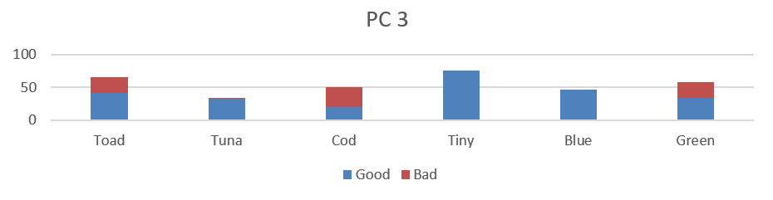
Methodology -Sequencing
Group
Sequence
BCD
Group
Sequence | Sum
 | Purity
Notes:
此處嘗試以不同的方式，
排序著6個二元特徵

Slide 31
Methodology -Sequencing
Group
Sequence
BCD
Group
Sequence | Sum
 | Purity
Column Sum
Type Purity
Notes:
如圖，是依據特徵總合排序，
二元特徵總合，通常表示了，類別的出現頻率。
此排序目的在，將總和較少的特徵，置於群組左方
而這些少量樣本，便會在編碼時，被投影數線上較遠的位置
以利區分出這些與眾不同、較偏離整體資料分布的離群樣本。

Slide 32
Methodology -Sequencing
Group
Sequence
BCD
Group
Sequence | Sum
 | Purity
Column Sum
Type Purity
Notes:
如圖，則是依據，類別純粹度，進行排序
目的在於，將最有分類價值、純度越高的資料分布於群組的前端、與後端
在編碼時，類別便會因為這些前後方、含有分類資訊的特徵，而被區分出來

Slide 33
Methodology -BCD code
Group
Sequence
BCD
Finally, using Binary Coded Decimal to compute the numerical values representing the feature groups.
BCD
Ranked BCD
Decimal digit | BCD
 | 8 | 4 | 2 | 1
0 | 0 | 0 | 0 | 0
1 | 0 | 0 | 0 | 1
2 | 0 | 0 | 1 | 0
3 | 0 | 0 | 1 | 1
4 | 0 | 1 | 0 | 0
5 | 0 | 1 | 0 | 1
6 | 0 | 1 | 1 | 0
7 | 0 | 1 | 1 | 1
8 | 1 | 0 | 0 | 0
9 | 1 | 0 | 0 | 1
Notes:
最後一步，便是以Binary coded decimal ，協助轉換，特徵組成為整數型別。
BCD的概念，其實相當直接，即是將一連串的，二元數值十位數化。
假設某樣本，在一特徵組內，依序為0、1、1、0，
則其轉換後的，十位數表示為6，便以6作為該樣本的數值

Slide 34
Methodology -BCD code
Group
Sequence
BCD
Group
Sequence
BCD |  | Sorted Column Group |  |  |  |  |  |  | Type
 |  | Blue | Tuna | Tiny | Toad | Green | Cod
33 |  | 1 | 0 | 0 | 0 | 0 | 1 |  | Good
36 |  | 1 | 0 | 0 | 1 | 0 | 0 |  | Good
26 |  | 0 | 1 | 1 | 0 | 1 | 0 |  | Bad
14 |  | 0 | 0 | 1 | 1 | 1 | 0 |  | Bad
Notes:
在此，則以先前已由，PCA群組、純粹度排序的特徵組為例

Slide 35
Methodology -BCD code
Group
Sequence
BCD
Group
Sequence
BCD |  | Sequenced features |  |  |  |  |  |  | Type
 |  | Blue | Tuna | Tiny | Toad | Green | Cod
33 |  | 1 | 0 | 0 | 0 | 0 | 1 |  | Good
36 |  | 1 | 0 | 0 | 1 | 0 | 0 |  | Good
26 |  | 0 | 1 | 1 | 0 | 1 | 0 |  | Bad
14 |  | 0 | 0 | 1 | 1 | 1 | 0 |  | Bad
Notes:
可見在，Blue這個欄位中，僅具有健康的樣本
而愈左側的特徵，對於BCD數值，具有更大的影響；
同時，加上採用了純粹度的排序，
越左側的特徵，在比例上有著更多的健康樣本。
因此，健康樣本傾向產出更大的BCD數值
反之，生病樣本產生較小的BCD數值

Slide 36
Methodology -BCD code
Group
Sequence
BCD
Group
Sequence
BCD |  | Sequenced features |  |  |  |  |  |  | Type
 |  | Blue | Tuna | Tiny | Toad | Green | Cod
33 |  | 1 | 0 | 0 | 0 | 0 | 1 |  | Good
36 |  | 1 | 0 | 0 | 1 | 0 | 0 |  | Good
26 |  | 0 | 1 | 1 | 0 | 1 | 0 |  | Bad
14 |  | 0 | 0 | 1 | 1 | 1 | 0 |  | Bad
Notes:
如此一來，經由純粹度排序的特徵組
相比於原先的，群組順序而言，更能導出，容易分類的數值資料
以此，達到較好的分類成果。

Slide 37
Methodology -BCD code
Group
Sequence
BCD
Notes:
然而，新編碼過後BCD數值，可能因為原先數字1的，個數較為稀少
導致編碼後的數值資料，全距過大、且分布稀疏。
X
例如：若組內二元特徵的個數為十個，則此群組編碼出的新數值特徵範圍將達到0至1024之間。
而在這0至1024的數線之上的資料呈現零散分佈

Slide 38
Methodology -BCD code
Group
Sequence
BCD
Notes:
為此，可嘗試透過BCD編碼排名
根據BCD大小進行排序，以取代BCD數值
可以有效改善編碼後，資料間的稀疏程度，以及數值差異過大，的問題
X
但對於分類模型而言，僅需在數線上決定切分點，不論資料全距，兩者的差異對分類模型的影響並不是相當顯著

Slide 39
Methodology -sum up
1. | Grouping
 | Clustering related or similar columns into groups.
2. | Sequencing
 | Sort the columns in the group with different column properties.
3. | Binary-Coded Decimal
 | Transform column groups into a numerical value with BCD.
Original
Randomly
Impurity
Notes:
以上便是，本研究提出方法的介紹
接著，會在案例分析中，來試驗本方法的可行性
X
首先第一步驟是依照聚類、或是特徵選取的方式群組二元特徵
並接著對各個特徵組內的二元特徵進行一致性的排序，
以求產生出有著更具有判別性、分類優勢的整數資料
最後藉由Binary coded decimal，協助轉換各個二元特徵組成為整數特徵

Slide 40
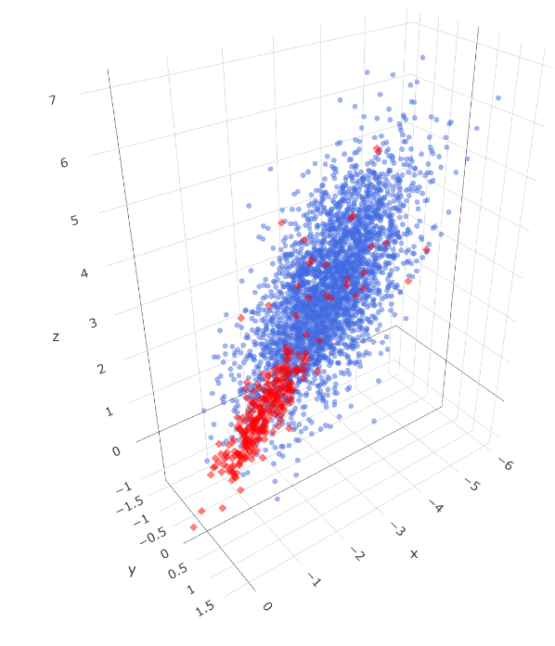

Case study
We compare classification results with the commonly used variable encoding method under different datasets.
Simulated continuous datasets
Kaggle-Feature encoding challenge dataset
Notes:
在案例分析中，我將提及，兩種資料集
分別是，模擬的三維連續資料；
與Kaggle網站上的開源資料
用以對比，我們所發展方法、與傳統編碼方式之下，
所產生的新數值資料，對於機器學習模型，分類成效的影響。

Slide 41
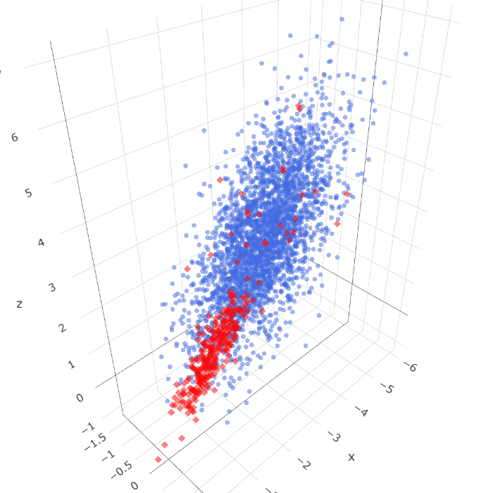
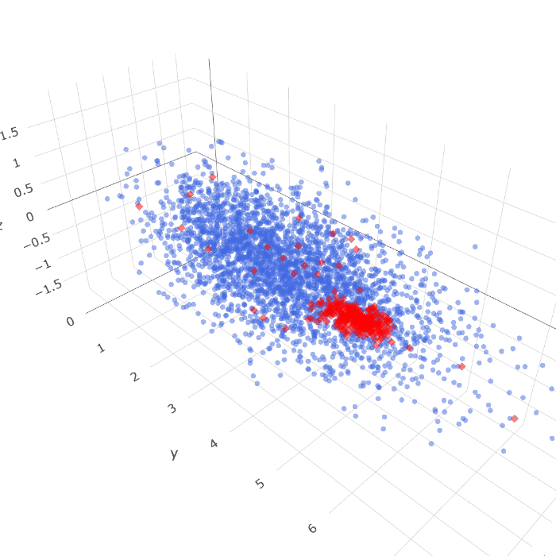
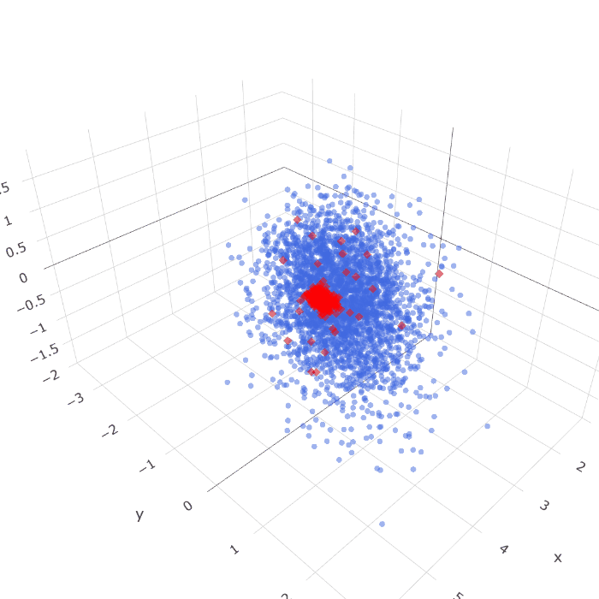
Simulated data -(3300 samples, 3000 Good, 300 Bad)
Dataset 1 |  | Dataset 2 |  | Dataset 3
Notes:
為了讓模擬資料，具備分類價值，我們依照三維座標點分布，
生成了兩種類別，的浮點數座標
其中以藍色作為多數、紅色作為少數樣本
在此將，針對此三種連續資料集，做討論。
X
資料點具有X、Y、Z三維座標資訊，且區分為三百個紅色的少數類別、與三千個藍色的多數類別；兩種類別各自服從自身的資料分布，
且在多數的藍色類別中，可見到有少量的紅色類別躁點存在，目的在於增加分類任務的複雜度。
其中資料集一二兩種類別較為混雜；而資料集三中類別間則較為分散，表示其較為容易分類

Slide 42
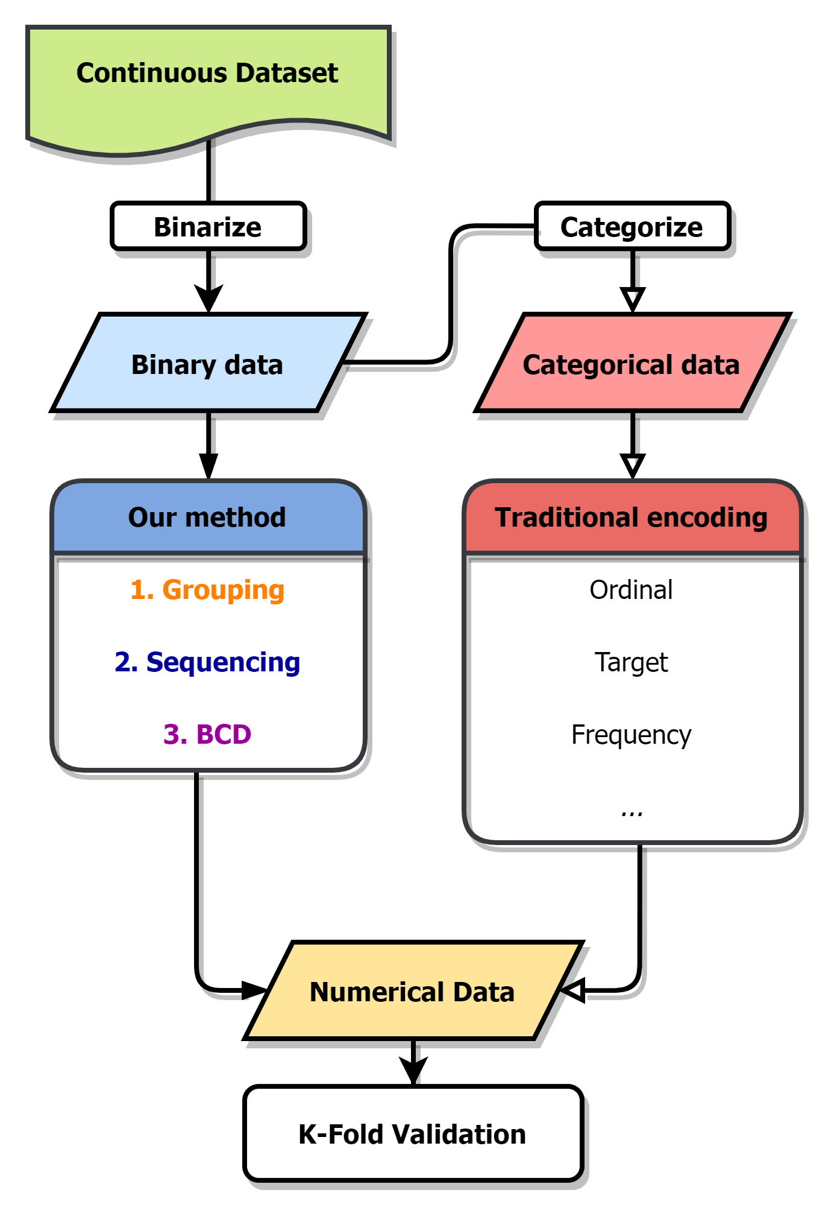
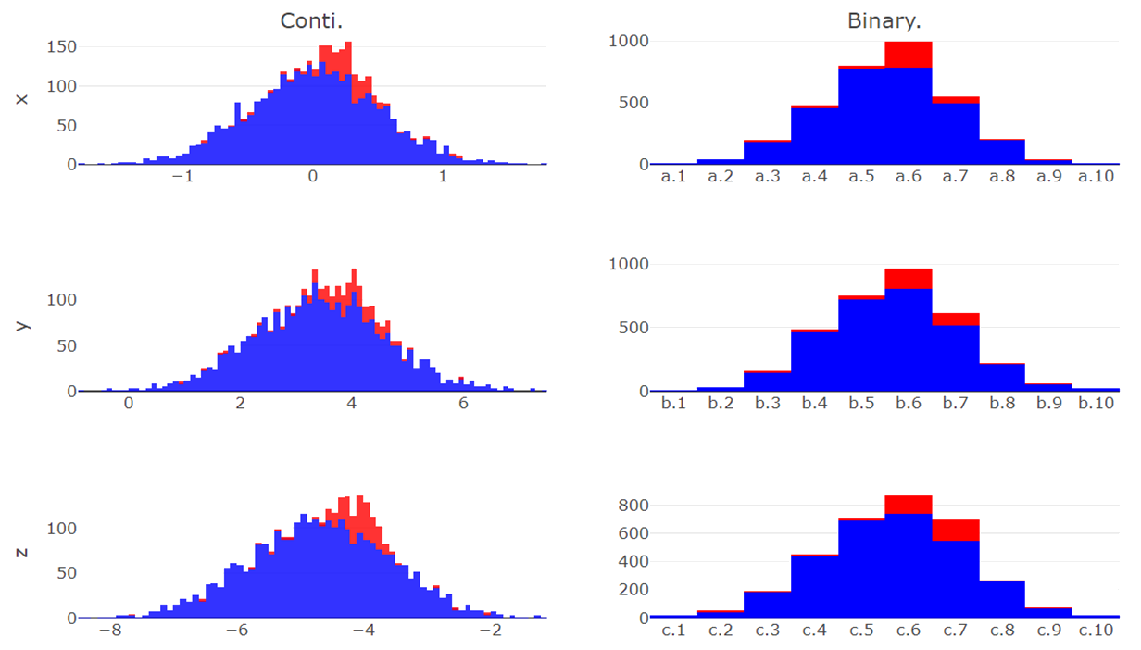
z.1 | z.2 | z.3 | z.4 | z.5 | z.6 | z.7 | z.8 | z.9 | z.10
y.1 | y.2 | y.3 | y.4 | y.5 | y.6 | y.7 | y.8 | y.9 | y.10
x.1 | x.2 | x.3 | x.4 | x.5 | x.6 | x.7 | x.8 | x.9 | x.10
Simulated data - binarize
Continuous Data | Binarize Data
counts
counts
X
counts
counts
Y
counts
counts
Z
Notes:
左圖為，整體實驗流程，
首先，由連續資料產生二元特徵，以作為本研究方法輸入
再轉換出類別特徵，以同時比較，傳統變數編碼
最後，根據不同的編碼，產生數值資料，再以k-fold 驗證，進行分類成果的比較
X
此分佈圖表示了原始連續資料於三個座標軸上的資料分布情形，且少數與多數類別由顏色區分；
而後根據欲劃分出的二元特徵個數，對此三個連續座標軸進行二元化處理

Slide 43
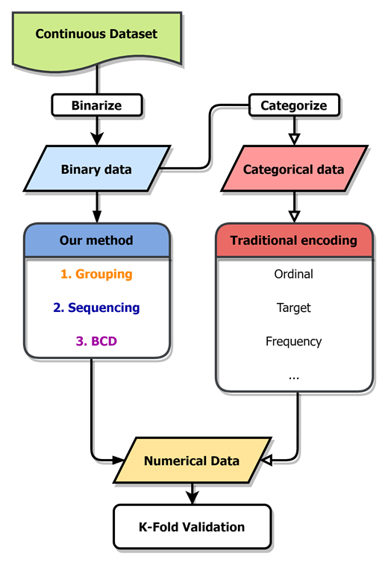
z.1 | z.2 | z.3 | z.4 | z.5 | z.6 | z.7 | z.8 | z.9 | z.10
y.1 | y.2 | y.3 | y.4 | y.5 | y.6 | y.7 | y.8 | y.9 | y.10
x.1 | x.2 | x.3 | x.4 | x.5 | x.6 | x.7 | x.8 | x.9 | x.10
Simulated data - binarize
Continuous Data | Binarize Data
counts
counts
X
counts
counts
Y
counts
counts
Z
Notes:
第一步，便是決定二元特徵的，目標個數
假設想，產生出30個二元特徵，
便依據比例，切分各個座標軸的全距
並將資料點，劃分到所屬的範圍中，如此，
我們便產生了，具備分類知識的，二元特徵資料

Slide 44
z.1 | z.2 | z.3 | z.4 | z.5 | z.6 | z.7 | z.8 | z.9 | z.10
y.1 | y.2 | y.3 | y.4 | y.5 | y.6 | y.7 | y.8 | y.9 | y.10
x.1 | x.2 | x.3 | x.4 | x.5 | x.6 | x.7 | x.8 | x.9 | x.10
Simulated data - Categorize
Categorical Data | Binarize Data
Instances | X | Y | Z
1 | x.2 | y.9 | z.4
2 | x.1 | y.8 | z.2
3 | x.9 | y.1 | z.6
4 | x.5 | y.7 | z.8
5 | x.3 | y.1 | z.8
6 | x.5 | y.6 | z.3
7 | x.7 | y.5 | z.4
⁝ | ⁝ | ⁝ | ⁝
3300 | x.4 | y.8 | z.1
Instances | x.1 | x.2 | x.3 | x.4 | x.5 | x.6 | … | z.9 | z.10
1 | 0 | 1 | 0 | 0 | 0 | 0 | … | 0 | 0
2 | 1 | 0 | 0 | 0 | 0 | 0 | … | 0 | 0
3 | 0 | 0 | 0 | 0 | 0 | 0 | … | 0 | 0
4 | 0 | 0 | 0 | 0 | 1 | 0 | … | 0 | 0
5 | 0 | 0 | 1 | 0 | 0 | 0 | … | 0 | 0
6 | 0 | 0 | 0 | 0 | 1 | 0 | … | 0 | 0
7 | 0 | 0 | 0 | 0 | 0 | 0 | … | 0 | 0
⁝ | ⁝ | ⁝ | ⁝ | ⁝ | ⁝ | ⁝ | ⁝ | ⁝ | ⁝
3300 | 0 | 0 | 0 | 1 | 0 | 0 | … | 0 | 0
Notes:
而以表格方式，呈現被二元化的，連續座標軸
可見，原先三維的連續資料，
以被劃分成為，30個二元特徵

Slide 45
Simulated data - Categorize
Categorical Data | Binarize Data
Instances | X | Y | Z
1 | x.2 | y.9 | z.4
2 | x.1 | y.8 | z.2
3 | x.9 | y.1 | z.6
4 | x.5 | y.7 | z.8
5 | x.3 | y.1 | z.8
6 | x.5 | y.6 | z.3
7 | x.7 | y.5 | z.4
⁝ | ⁝ | ⁝ | ⁝
3300 | x.4 | y.8 | z.1
Instances | x.1 | x.2 | x.3 | x.4 | x.5 | x.6 | … | z.9 | z.10
1 | 0 | 1 | 0 | 0 | 0 | 0 | … | 0 | 0
2 | 1 | 0 | 0 | 0 | 0 | 0 | … | 0 | 0
3 | 0 | 0 | 0 | 0 | 0 | 0 | … | 0 | 0
4 | 0 | 0 | 0 | 0 | 1 | 0 | … | 0 | 0
5 | 0 | 0 | 1 | 0 | 0 | 0 | … | 0 | 0
6 | 0 | 0 | 0 | 0 | 1 | 0 | … | 0 | 0
7 | 0 | 0 | 0 | 0 | 0 | 0 | … | 0 | 0
⁝ | ⁝ | ⁝ | ⁝ | ⁝ | ⁝ | ⁝ | ⁝ | ⁝ | ⁝
3300 | 0 | 0 | 0 | 1 | 0 | 0 | … | 0 | 0
Notes:
而根這30個二元特徵，與其群組資訊，
得以轉化出資料的，類別形式
這兩種資料，其實是一體兩面的
僅僅在呈現方式上有所差異
類似於由，獨熱編碼，轉換類別特徵為，二元的形式
如此，便得以為我們的方法，與傳統變數編碼，設定出相同的比較基準

Slide 46
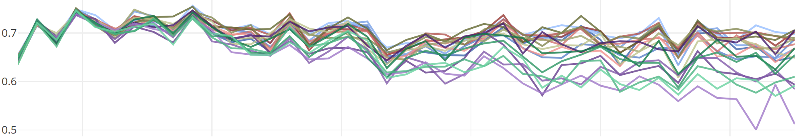
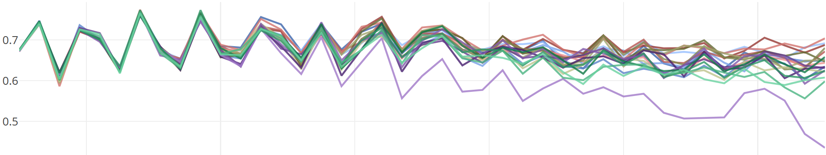
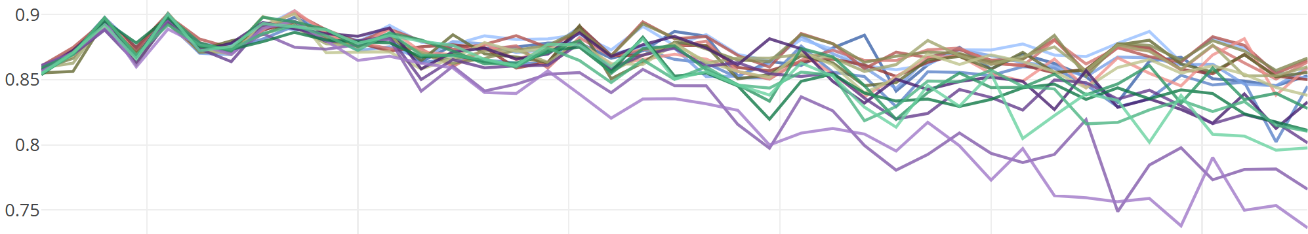
Simulated data -Classification
Dataset 1
Dataset 2
Dataset 3
Traditional | OneHot
 | Ordinal
 | Binary
 | Target
Default | Sum
 | Purity
 | FI
 | RND
Correlation | Sum
 | Purity
 | FI
 | RND
PCA | Sum
 | Purity
 | FI
 | RND
RND | Sum
 | Purity
 | FI
 | RND
40 | 60 | 80 | 100 | 120 | 140
Notes:
此折線圖，顯示了三種資料，在不同的二元特徵個數之下，各種編碼方法由k-folds驗證後，平均f1 score的變化
在傳統編碼中，我們選擇了 Binary, Ordinal, 與Target 來一起比較分類成果
以及本研究提出的，四種群組方式，分別是根據，原先群組資訊、主成分分析、相關係數與隨機群組
再，分別結合4種排序方式，分別是特徵總和、純粹度、重要性、與隨機排列
最後，以LightGBM，產生梯度提升決策樹，作為分類模型，並以f1 score作為分類表現的，衡量標準
由此三張折線圖可見，當二元變數數量增加時，
分類成績平均下降、但變異，卻逐漸增加，有類似維度災難的情形發生。
也表示編碼方式，對分類成績，有一定的影響，
同時也顯示了，適當的編碼方式，可以維持，模型對資料的分類成效

Slide 47
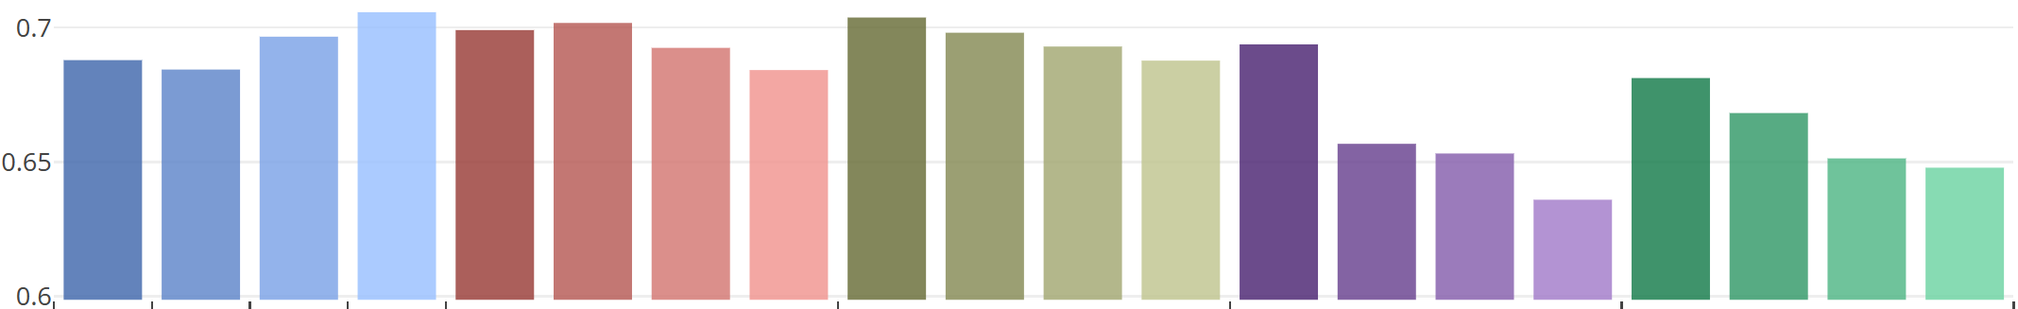
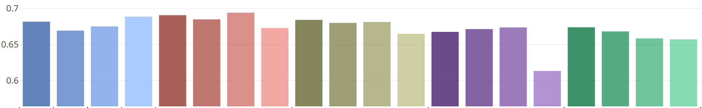
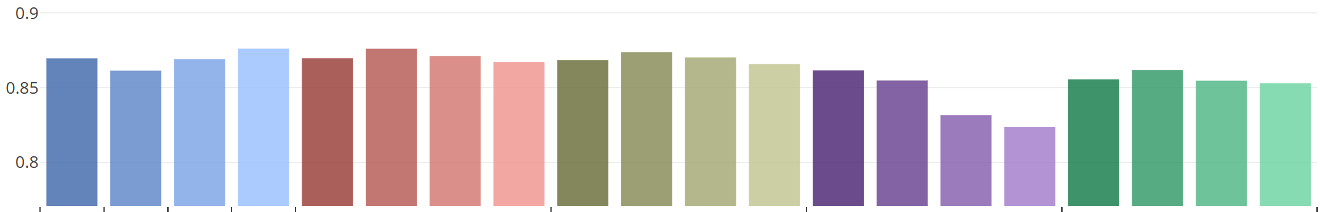
Simulated data -Classification
Dataset 1
Dataset 2
Dataset 3
Traditional | OneHot
 | Ordinal
 | Binary
 | Target
Default | Sum
 | Purity
 | FI
 | RND
Correlation | Sum
 | Purity
 | FI
 | RND
PCA | Sum
 | Purity
 | FI
 | RND
RND | Sum
 | Purity
 | FI
 | RND
Notes:
此直方圖則表示了，折線圖的平均成績
其中，值得注意的有以RND排序方式，皆產出該群組中，最低的分類成績
以及，不同群組方式，也有著不同的平均成績，
可見群組、與排序方法，對於分類成果，具有一定程度的影響
而Target 編碼，皆具有不俗表現，因為它，跟我們方法中的純粹度、重要性相同
屬於一種監度式的編碼方式，
X

Slide 48
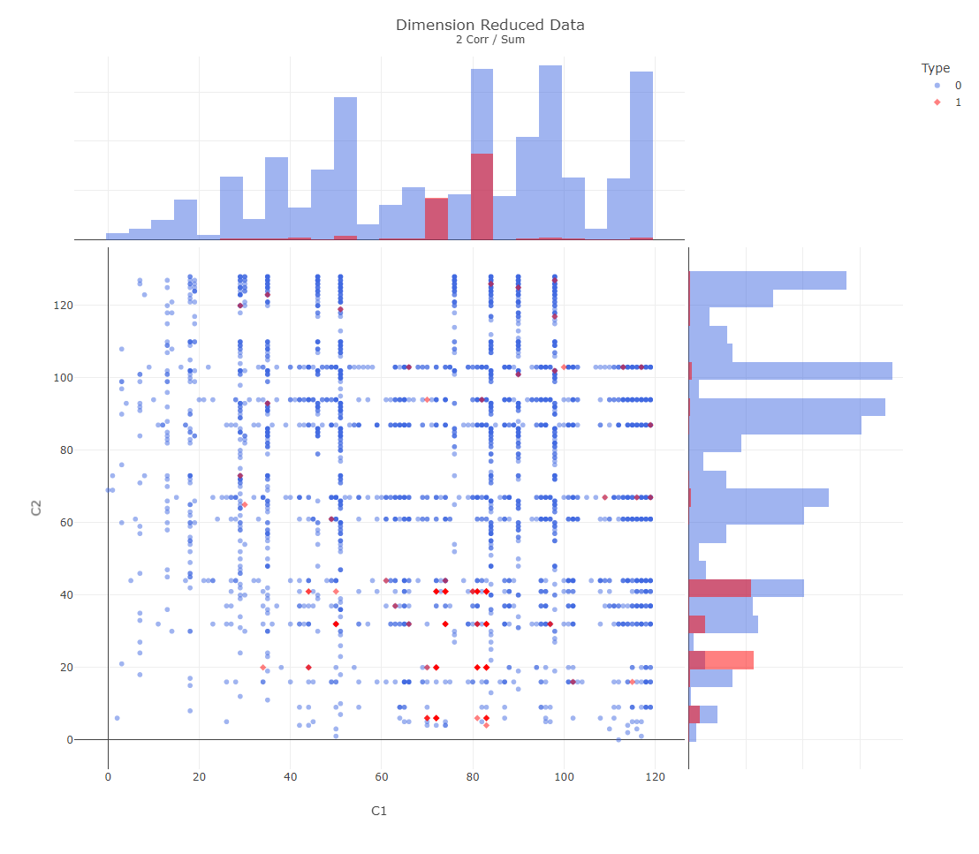
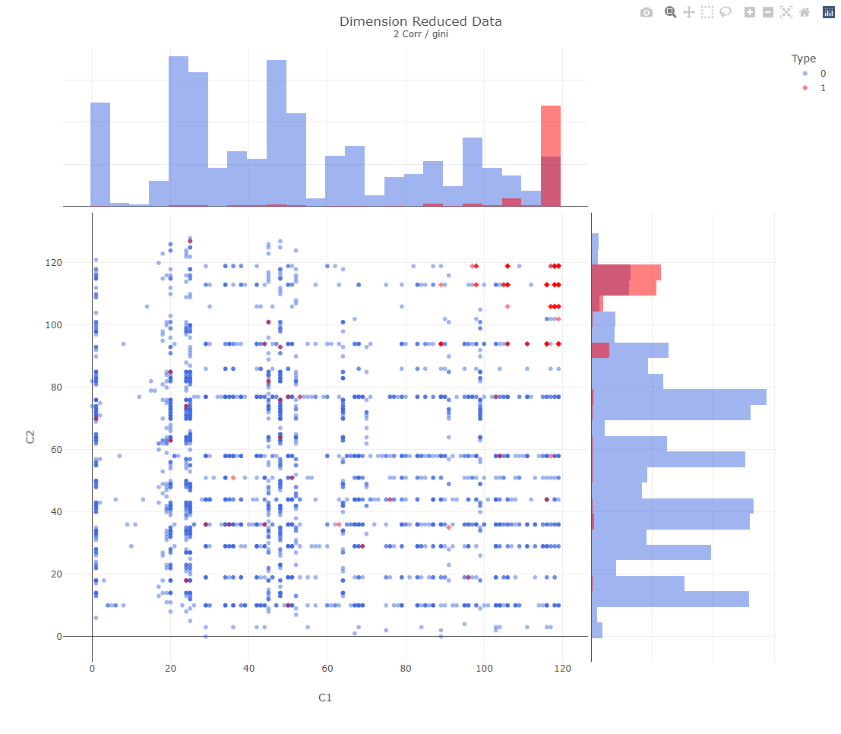
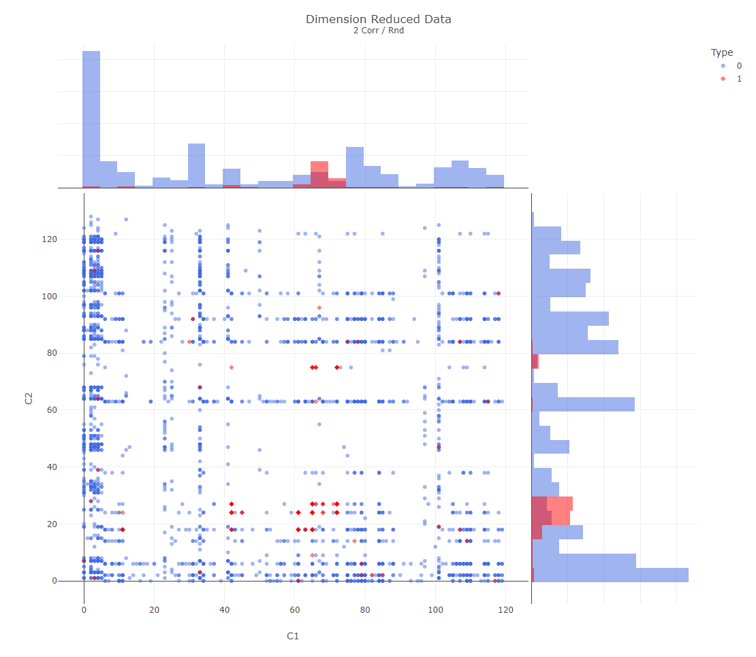
Simulated data -Dimension reduction
Sum | Impurity | RND
Notes:
我們所發展的編碼方式，也可以做為二元資料，的降維方法來使用。
可將，高維度的二元資料，轉變為群組個數維度下，的數值資料
若是設定成二維或是三維，即可視覺化該筆資料
進行資料分析的同時外，也可以比較，不同排序與群組方式間的差異。
如，此三張圖，便是在相同的群組方法下，經由不同的排序後，所產生的二維資料分佈
可以更明顯看出，以純粹度排序的資料，將產生更容易分類的數值，
X
它分別投影了兩種類別資料，到數線的兩端，讓類別更容易被區分

Slide 49
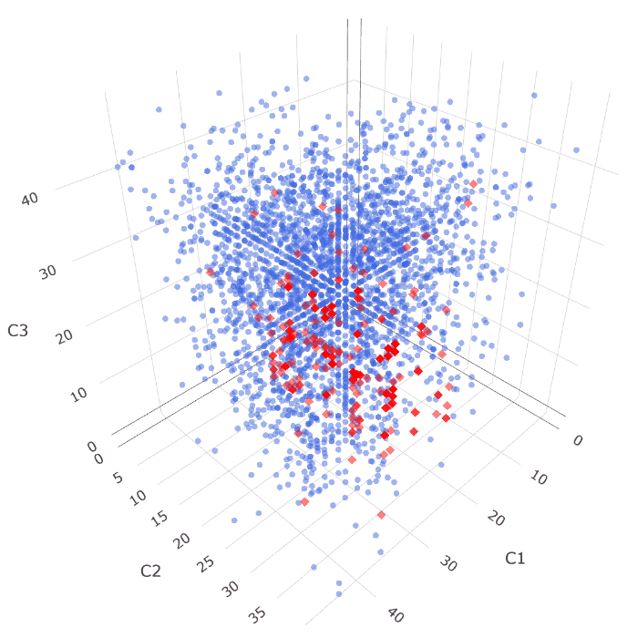
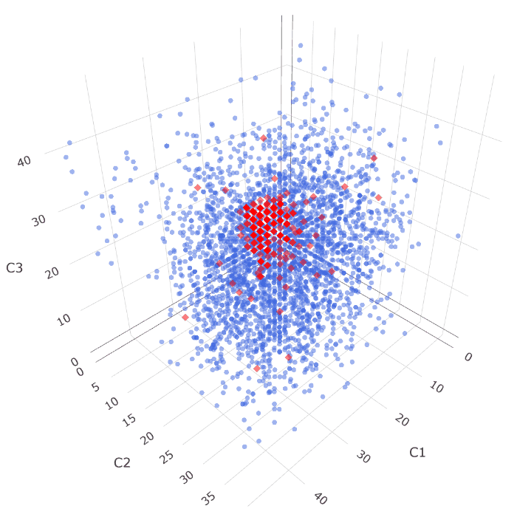
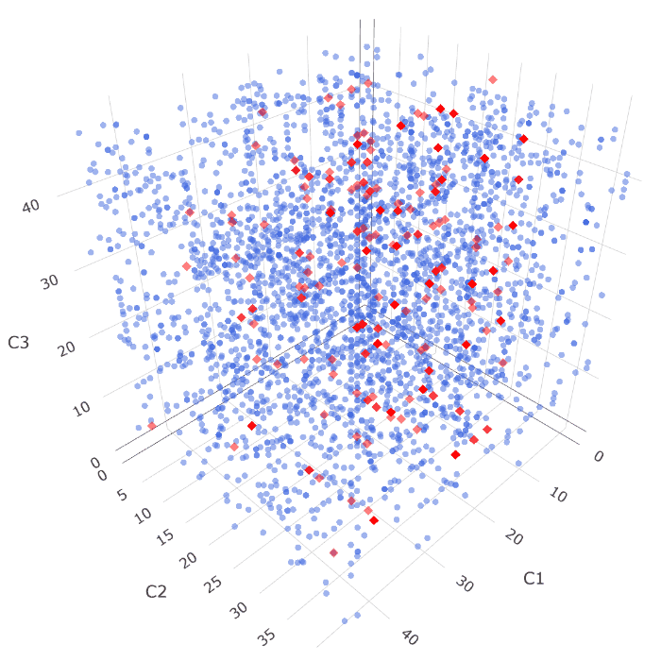
Simulated data -Dimension reduction
Sum | Impurity | RND
Notes:
也能將二元資料，投影到三個維度之下，能更明顯感受出，排序方法間的差異
若是以隨機排列，兩類資料則將相互混雜，無法找出個適合的切分點，來區隔出類別
最後，導致模型無法有效分類，使成果大受影響

Slide 50
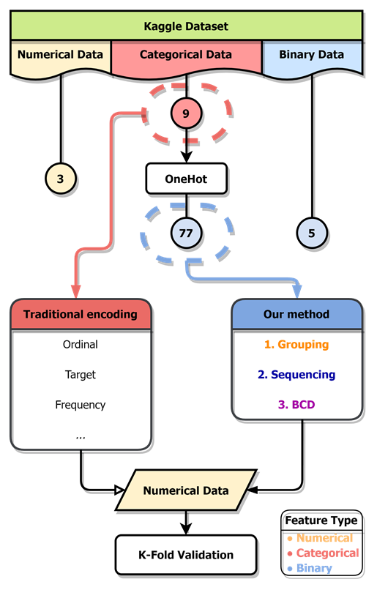
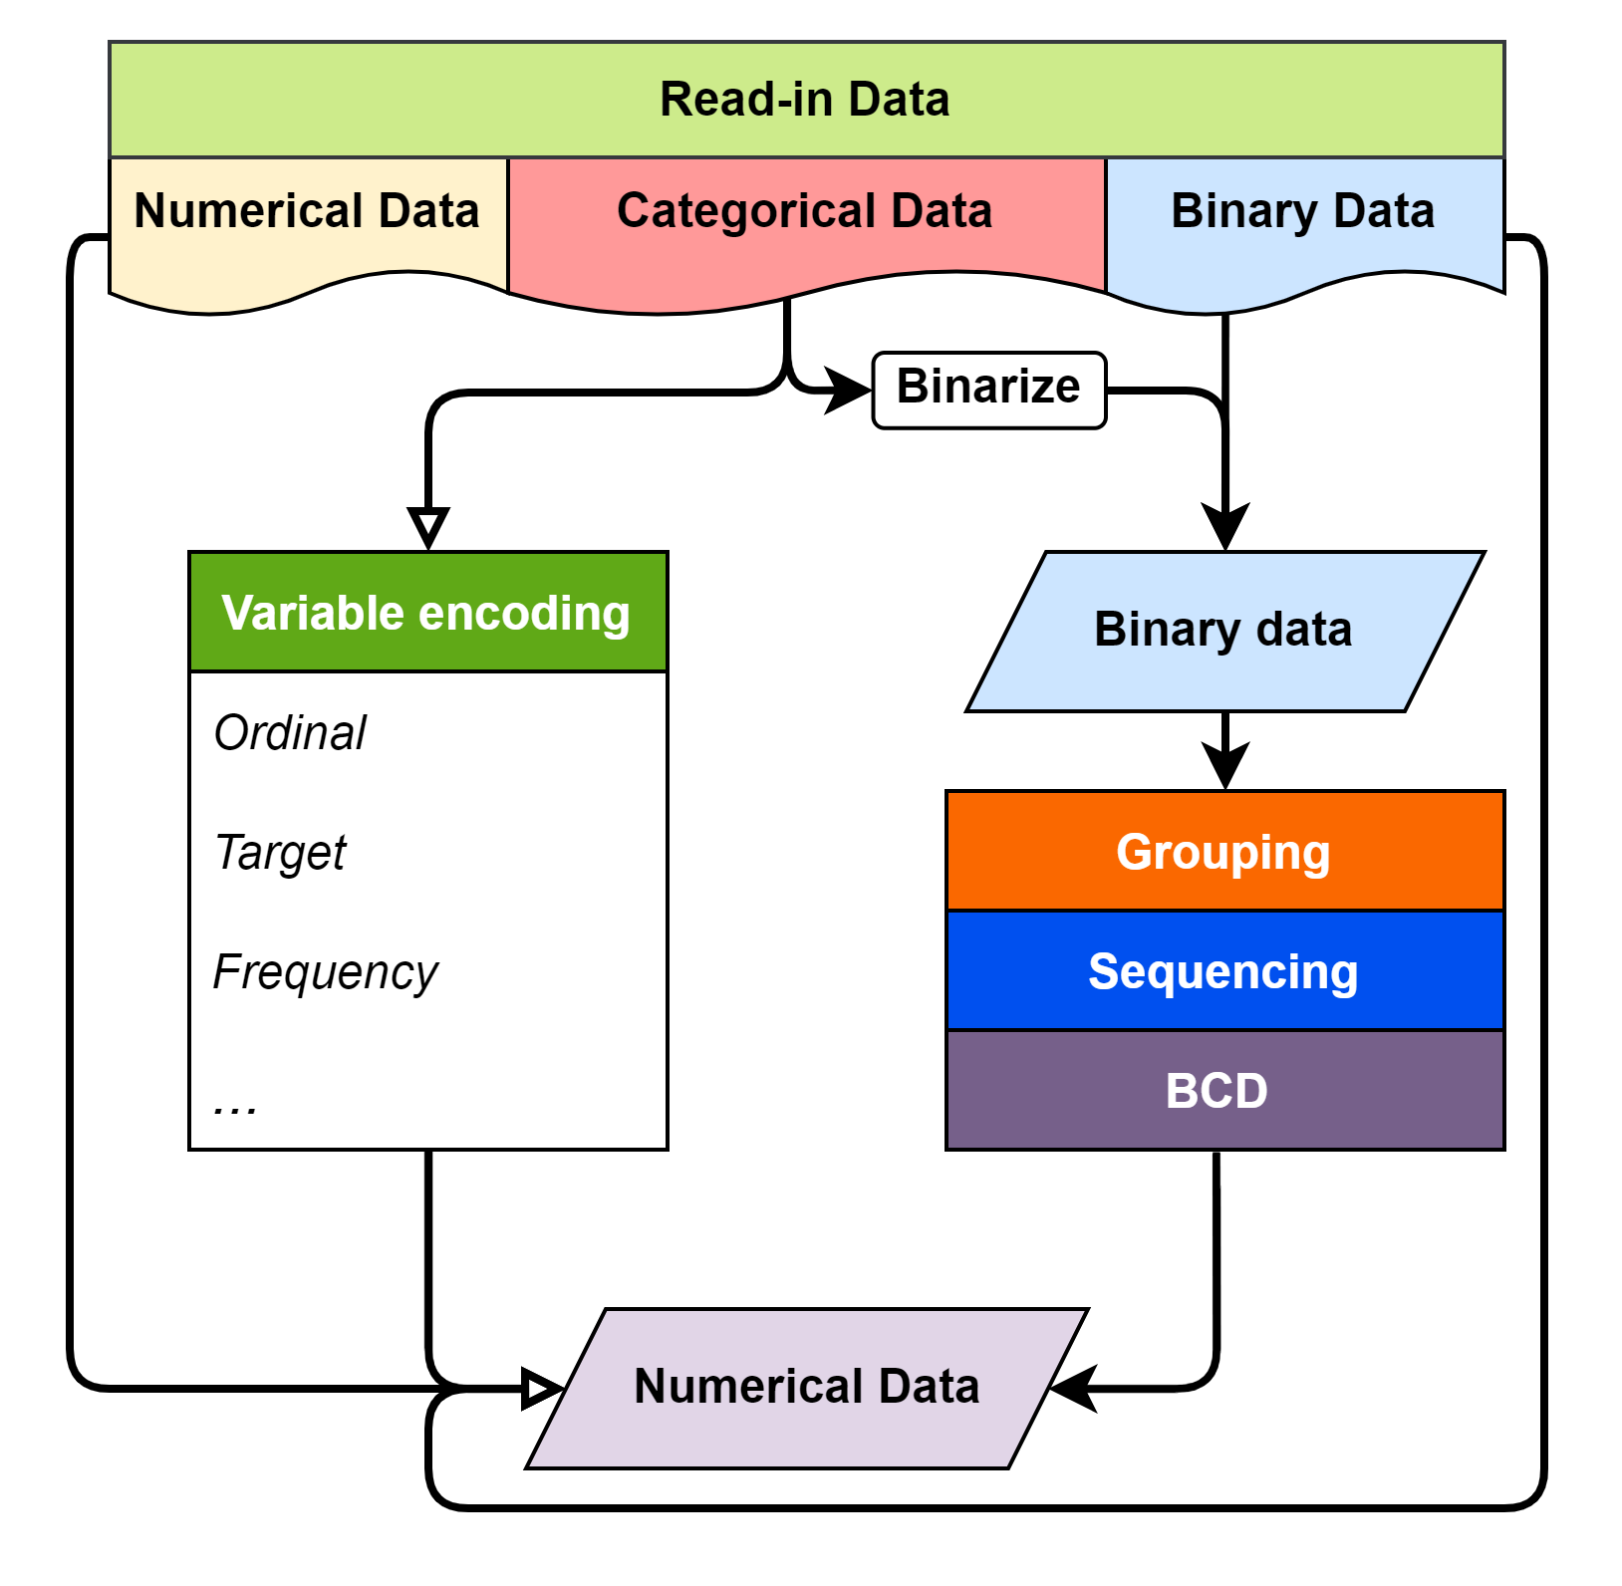
Kaggle dataset
Numerical feature uniqueness of Kaggle CFEC dataset
bin0 | bin1 | bin2 | bin3 | bin4 | ord0 | day | month | Target
0 | 0 | 0 | 0 | 0 | 1 | 1 | 1 | 0
1 | 1 | 1 | 1 | 1 | 2 | 2 | 2 | 1
 |  |  |  |  | 3 | 3 | 3
 |  |  |  |  |  | ⁝ | ⁝
 |  |  |  |  |  | 7 | 12
Categorical feature uniqueness of Kaggle CFEC dataset
nom0 | nom1 | nom2 | nom3 | nom4 | ord1 | ord2 | ord3 | ord4
Green | Triangle | Snake | Finland | Bassoon | Grandmaster | Cold | a | A
Blue | Trapezoid | Hamster | Russia | Piano | Expert | Hot | b | B
Red | Polygon | Lion | Canada | Theremin | Novice | Lava Hot | c | C
 | Square | Cat | Costa Rica | Oboe | Contributor | Boiling Hot | d | D
 | Star | Dog | China |  | Master | Freezing | ⁝ | ⁝
 | Circle | Axolotl | India |  |  | Warm | o | Z
Notes:
我們也有嘗試，應用到更加複雜的資料集中，
在此，選用了Kaggle網站上，關於類別特徵的，編碼挑戰資料集
它同時具備數值、類別與二元特徵，並且同樣作為分類問題；
而未經由編碼的數值、二元特徵，會在編碼後，被併入新的數值資料之中

Slide 51
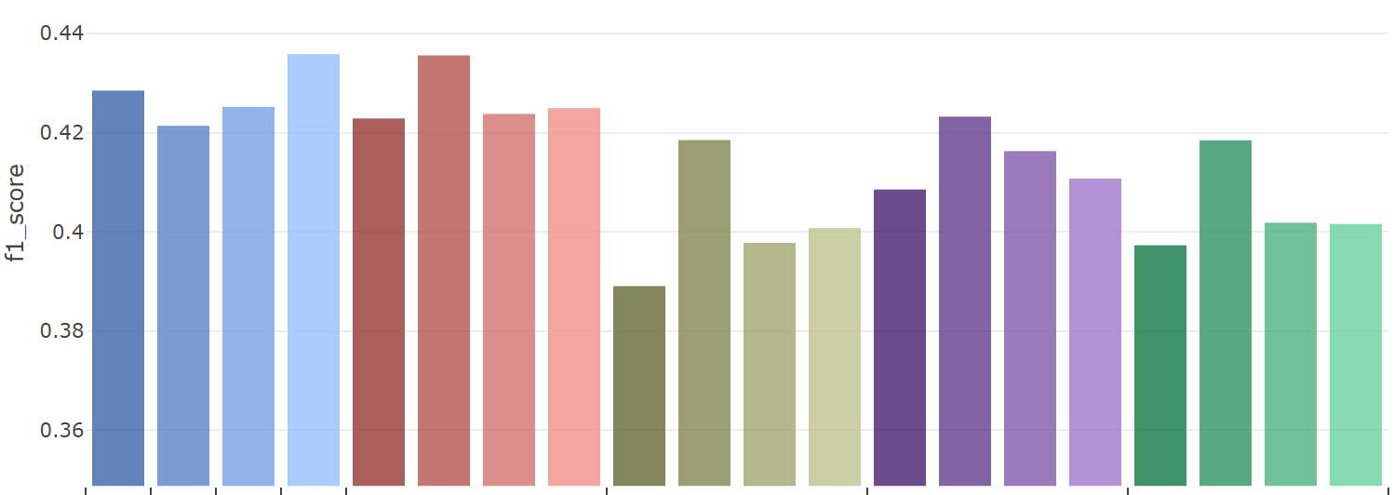
Kaggle dataset -Classification
Feature Encode Challenge
 | One Hot | Binary | Ordinal | Target | Sum | Purity | FI | RND | Sum | Purity | FI | RND | Sum | Purity | FI | RND | Sum | Purity | FI | RND
 | Traditional |  |  |  | Default |  |  |  | Correlation |  |  |  | PCA |  |  |  | RND
 | 85 | 37 | 17
Notes:
直方圖呈現了，不同編碼下，數值資料的k-folds驗證成績
底下，黑灰色欄位中的數字，表示了該方法，的數值資料特徵個數
可以明顯發現，分群與排序對於，資料集的分類成果的明顯影響。
像是在傳統的編碼之中，監督式的目標編碼，往往能明顯提升分類成績。
而不同的群組方式，也具有影響，依照原先資訊群組，通常將有著更高的平均分類成績，
而在各個群組方式中，可以發現，
以特徵純粹度排序，將有效提升編碼後，資料的分類成績。

Slide 52
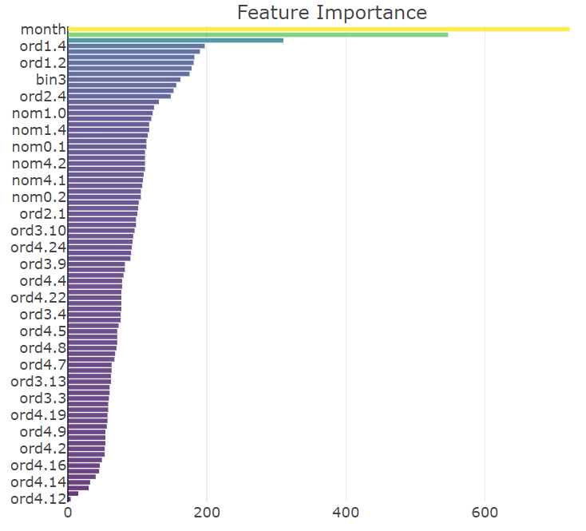
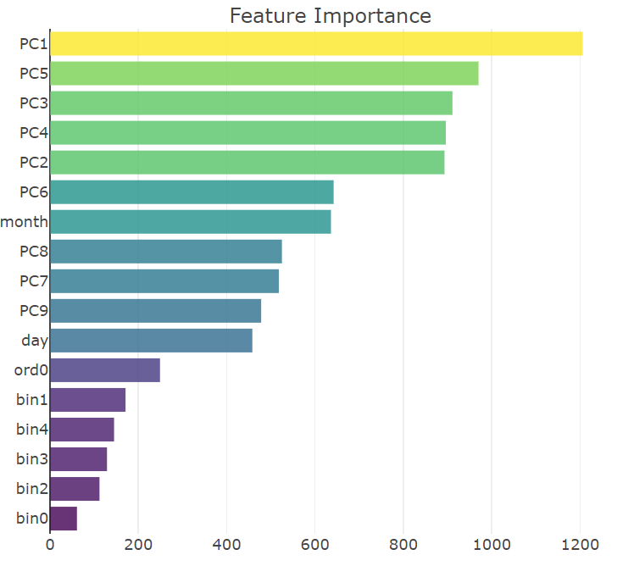
Kaggle dataset -Feature importance changes
Before Encoding | PCA-Purity
Notes:
在完成分類模型訓練後，也可以比較不同資料的，特徵重要度
可以發現，相較於編碼前的二元資料，
編碼後資料的，平均特徵重要度，有著顯著提升，
表示，原先難以用於，區分類別的二元特徵們，經由壓縮與融合，
傳換成了，更具有分類價值的，數值特徵。

Slide 53
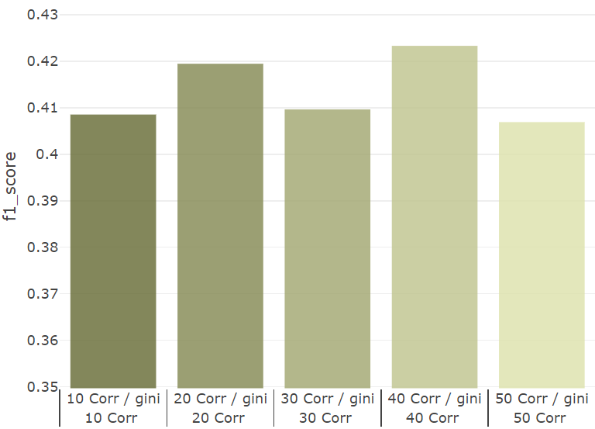
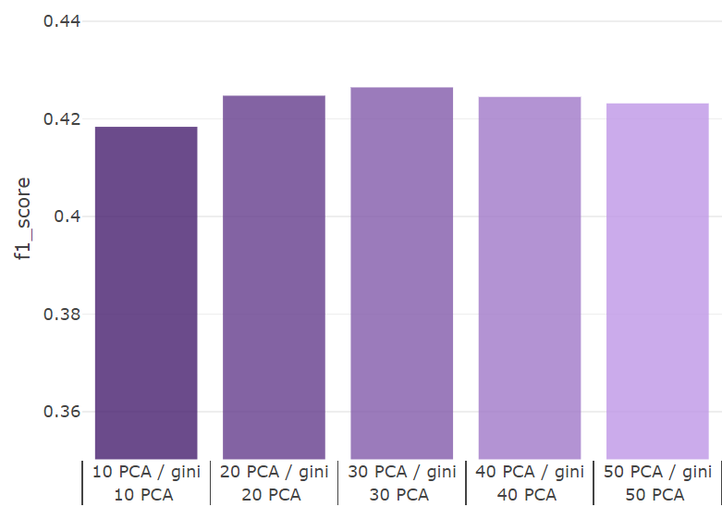
Kaggle dataset -Different grouping seizes
Correlation | PCA
 | Purity | Purity | Purity | Purity | Purity
 | Correlation
 | 10 | 20 | 30 | 40 | 50
 | Purity | Purity | Purity | Purity | Purity
 | PCA
 | 10 | 20 | 30 | 40 | 50
Notes:
因為本方法，可以自由的決定，想生成的特徵數量
此處便是嘗試，以不同的特徵數量，產生資料集做比較
可以發覺，分類成績有隨著群組個數，增加，而後而緩慢減少的趨勢，
整體有著類似於，維度災難的情形發生。

Slide 54
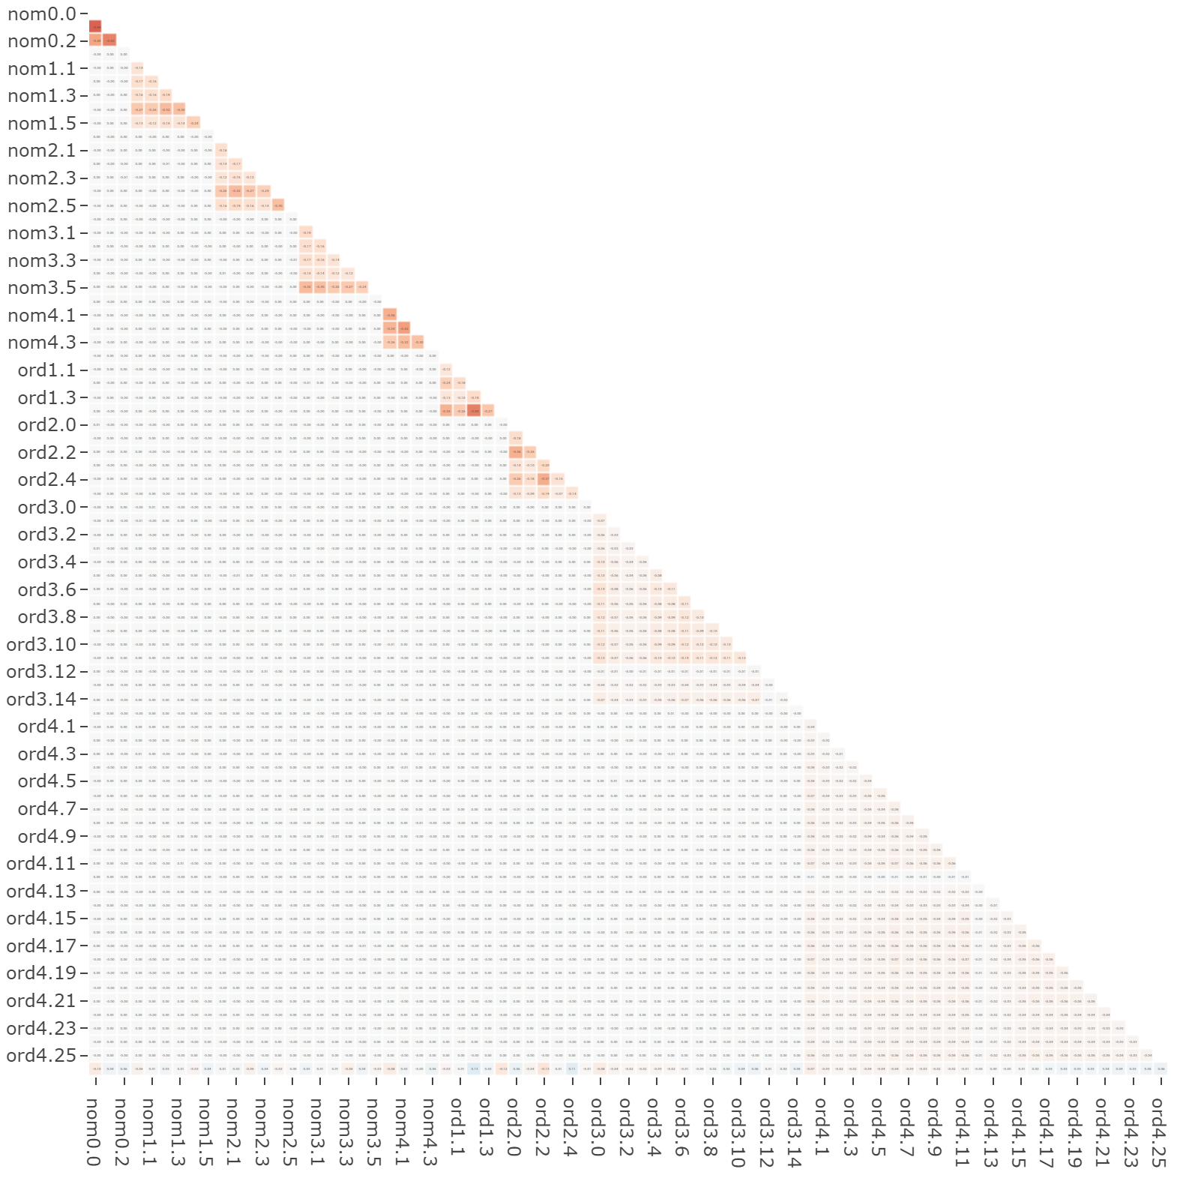
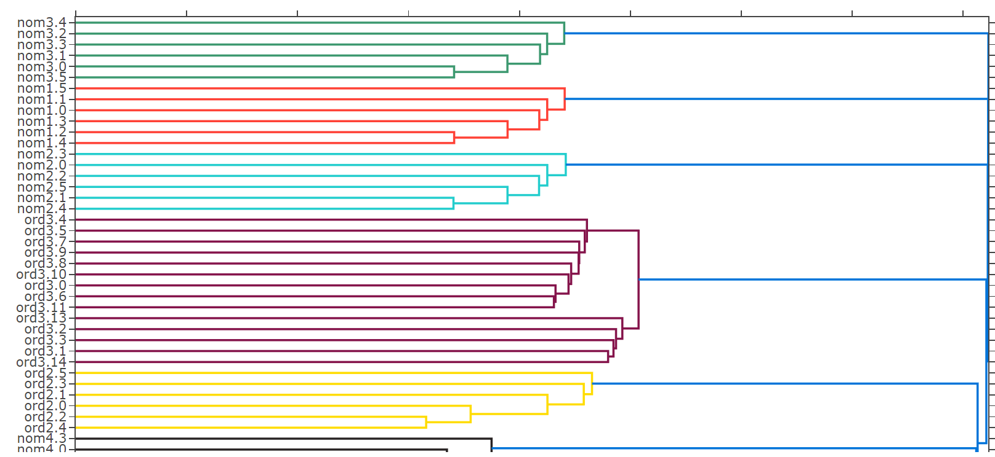
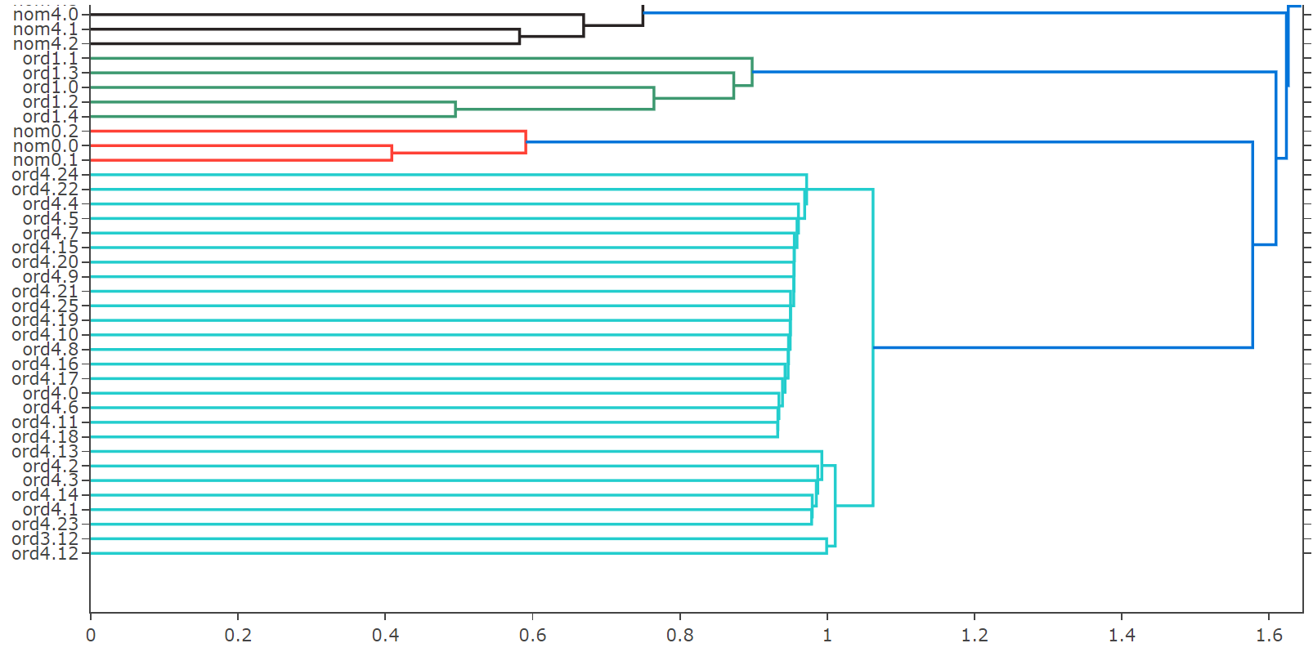
Kaggle dataset -Group by hierarchical clustering
Notes:
此處則改由，階層聚類模型，結合相關係數，進行特徵群組
可以找尋出，二元特徵間的互斥關係，並還原原始的群組資訊。
由此方法群組，將與原始的資訊群組，有著完全的分群結果
可將其作為，一種還原二元資料，群組資訊的方式

Slide 55
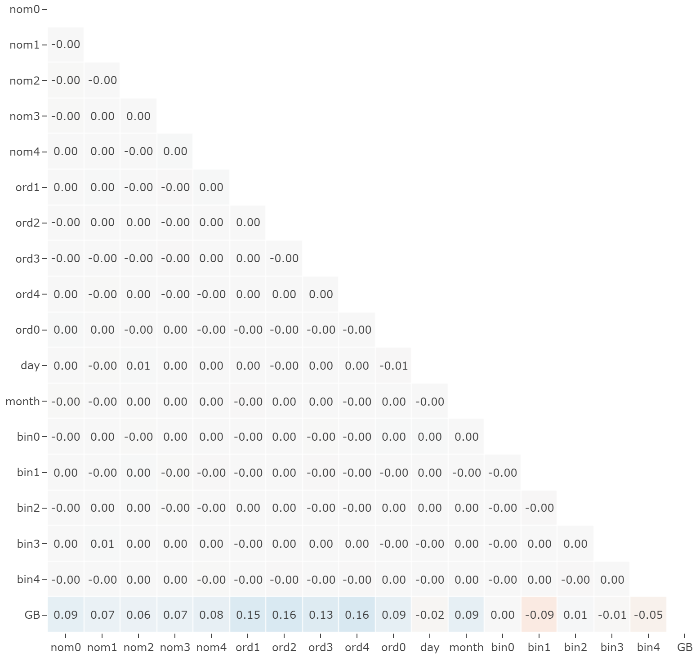
Kaggle dataset -Group by hierarchical clustering
Notes:
右圖為原始的群組資訊後，所產生的數值特徵相關性
也因為會有著，最小的關聯性，導致更加的分類成果主因
X
但作為本研究所預想的群組方式乃是著重在於藉由結合、群聚由不同類別特徵所產生的二元特徵，
以融合出更具有分類價值與資料特性的新數值特徵，
而此方法與依據原始群組資訊所產生特徵群組完全相同，
因此並未加入群組方法中與其餘方式做比較。

Slide 56
Conclusion
A new encoding scheme for binary data.
Compress binary features information into integers.
Preserve classification/regression performance with proposed grouping & sequencing techniques.
A dimension reduction method of high dimensional binary data.
Instances | x.1 | x.2 | x.3 | x.4 | x.5 | x.6 | … | z.9 | z.10
1 | 0 | 1 | 0 | 0 | 0 | 0 | … | 0 | 0
2 | 1 | 0 | 0 | 0 | 0 | 0 | … | 0 | 0
3 | 0 | 0 | 0 | 0 | 0 | 0 | … | 0 | 0
4 | 0 | 0 | 0 | 0 | 1 | 0 | … | 0 | 0
5 | 0 | 0 | 1 | 0 | 0 | 0 | … | 0 | 0
6 | 0 | 0 | 0 | 0 | 1 | 0 | … | 0 | 0
7 | 0 | 0 | 0 | 0 | 0 | 0 | … | 0 | 0
⁝ | ⁝ | ⁝ | ⁝ | ⁝ | ⁝ | ⁝ | ⁝ | ⁝ | ⁝
3300 | 0 | 0 | 0 | 1 | 0 | 0 | … | 0 | 0
Notes:
我們提出了一種，將二元資料編碼為，數值資料的架構設計
透過群組、排序與BCD碼的步驟，不論原先資料是否包含群組的資訊，皆可以將資料編碼成數值表示。
主要概念為，藉由特徵群組，得以壓縮高維度二元資料；
而後進行排序，以提升編碼資料的分類成績；
最終，藉由BCD編碼，將複數二元特徵，轉換成為單一整數數值。
或是改作為，降維方法，視覺化高維度的二元資料

Slide 57
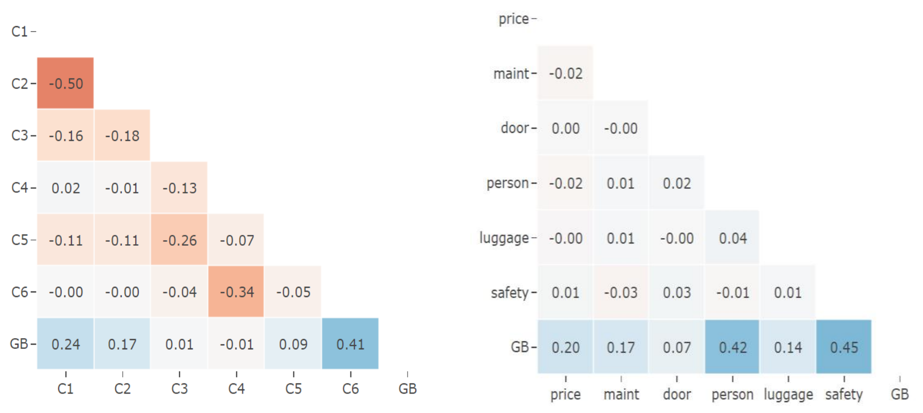
Future work
Grouping techniques can be further enhanced.
Finding the optimal dimension of the data.
Sequencing problem may be solved with optimization algorithms.
Rigorous mathematical/statistical derivations are needed.
Worse
Better
Notes:
在未來研究方向的部分，可以嘗試擴充現有的群組、排序方式
讓特徵群組間更為獨立、編碼數值更能區分類別
或是以數學、統計等方法，解析問題後
嘗試將群組、排序問題，透過最佳化模型求解等
皆可做為未來的研究目標

Slide 58
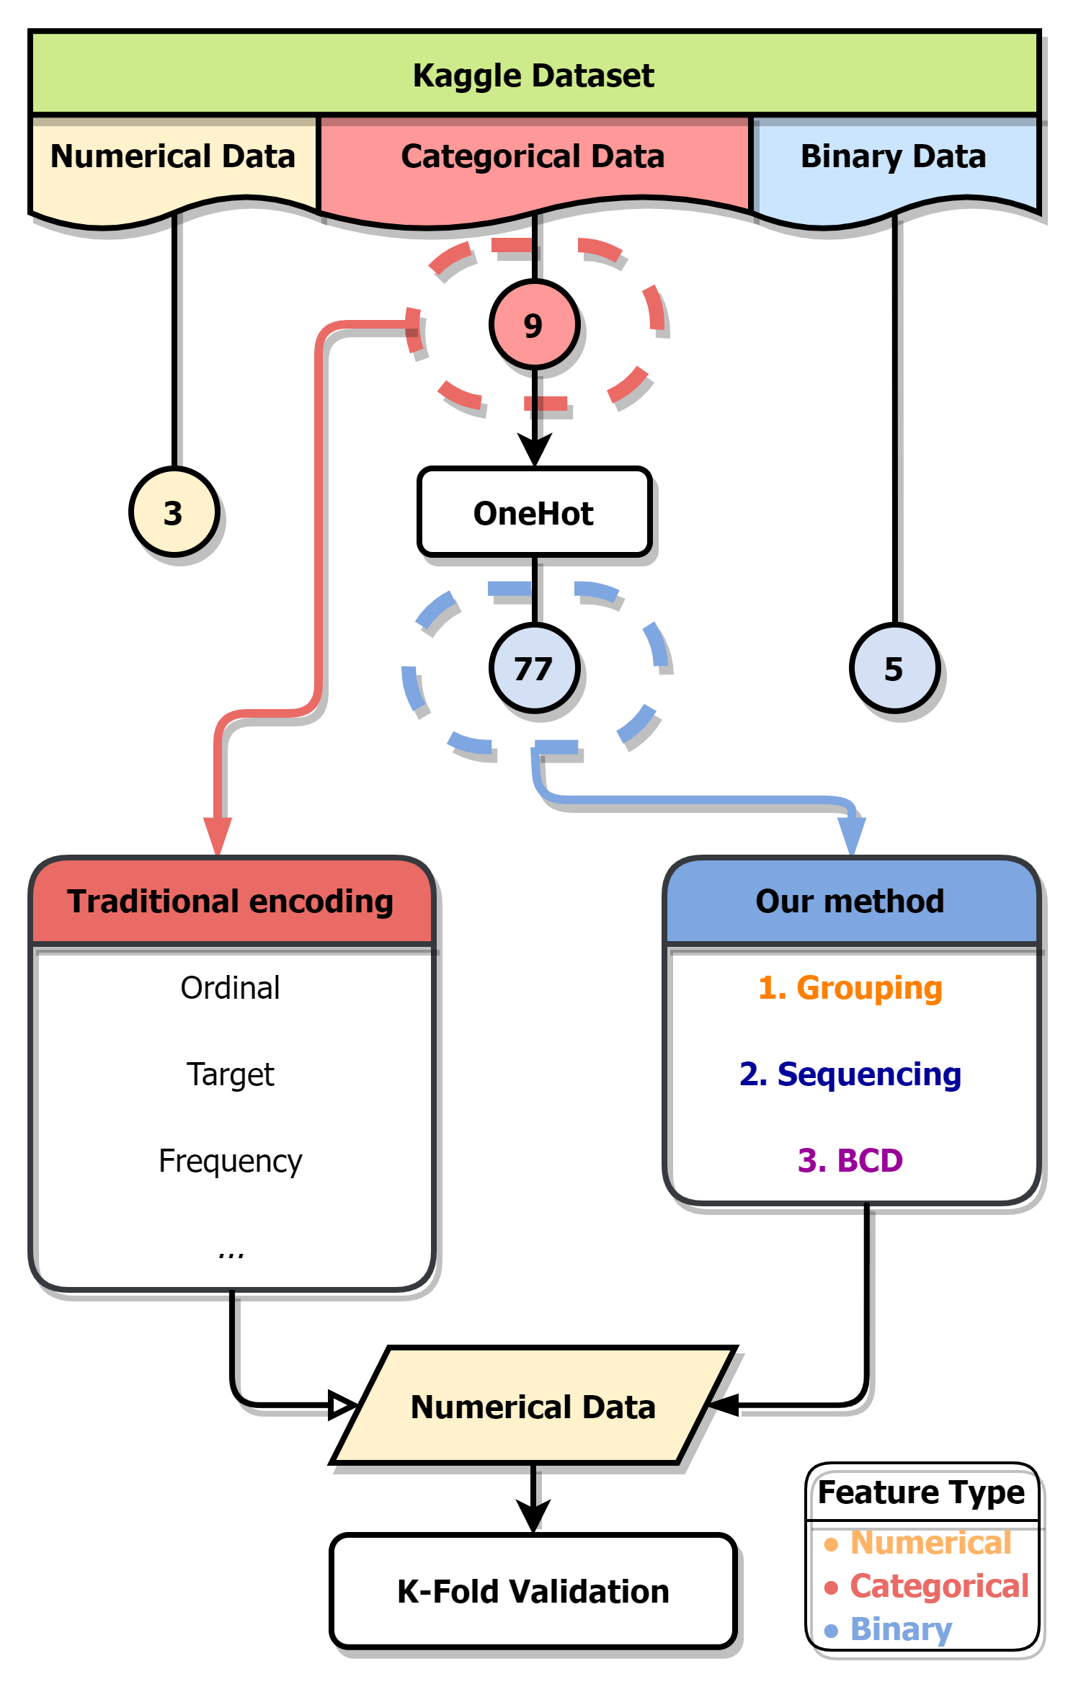
Kaggle dataset
Numerical feature uniqueness of Kaggle CFEC dataset
bin0 | bin1 | bin2 | bin3 | bin4 | ord0 | day | month | Target
0 | 0 | 0 | 0 | 0 | 1 | 1 | 1 | 0
1 | 1 | 1 | 1 | 1 | 2 | 2 | 2 | 1
 |  |  |  |  | 3 | 3 | 3
 |  |  |  |  |  | ⁝ | ⁝
 |  |  |  |  |  | 7 | 12
Categorical feature uniqueness of Kaggle CFEC dataset
nom0 | nom1 | nom2 | nom3 | nom4 | ord1 | ord2 | ord3 | ord4
Green | Triangle | Snake | Finland | Bassoon | Grandmaster | Cold | a | A
Blue | Trapezoid | Hamster | Russia | Piano | Expert | Hot | b | B
Red | Polygon | Lion | Canada | Theremin | Novice | Lava Hot | c | C
 | Square | Cat | Costa Rica | Oboe | Contributor | Boiling Hot | d | D
 | Star | Dog | China |  | Master | Freezing | ⁝ | ⁝
 | Circle | Axolotl | India |  |  | Warm | o | Z
Notes:
我們也有嘗試，應用到更加複雜的資料集中，
在此，選用了Kaggle網站上，關於類別特徵編碼挑戰資料集
，它同時具備數值、類別與二元特徵，並且同樣作為二元分類問題；
如右邊的流程圖可見，經由獨熱編碼後，9個類別特徵，將產生出77個二元特徵。
並分別作為傳統編碼，與我們方法的起始資料

Slide 59
Methodology -Grouping
Group
Sequence
BCD
Binary Data | Grouped by PCA
Notes:
在此，使用由PCA權重，產生的特徵群組
可見在產生的特徵組中，綜合了不同物種、尺寸與顏色的特徵

Slide 60

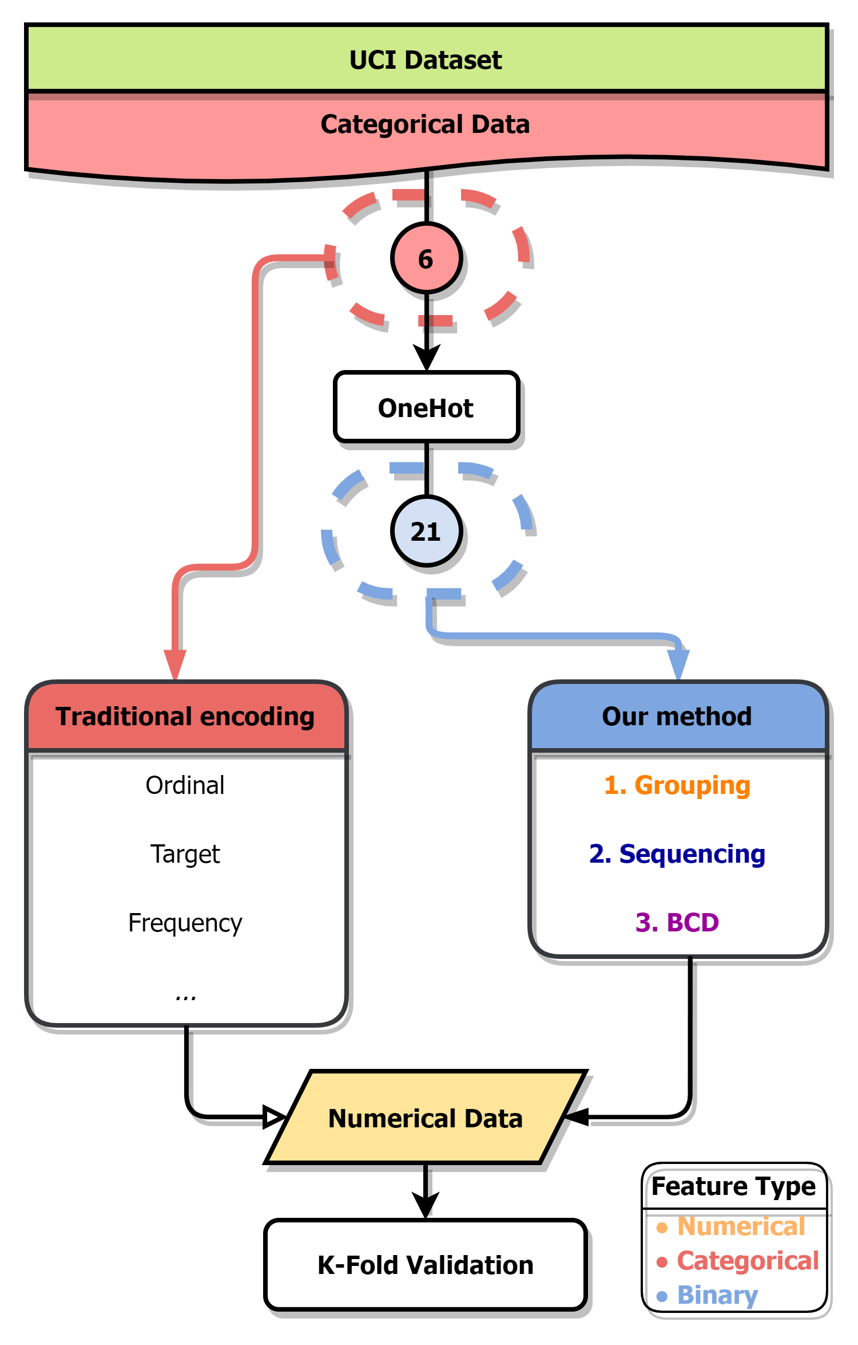
UCI dataset
Feature uniqueness of UCI car evaluation dataset
Price | Maintenance | Doors | Persons | Luggage boot | Safety | Evaluation
vhigh | vhigh | 2 | 2 | small | med | Acceptable
high | high | 3 | 4 | med | high | Unacceptable
med | med | 4 | more | big | low
low | low | 5more
Notes:
因應參考文獻中所涉及的變數編碼比較相關研究，於UCI線上資料及網站之中採用與其相同的標竿資料集，
此車輛評估資料集較為簡單，僅僅具有六個類別變數作為輸入，來預測車輛為可接受、或是不可接受的狀態

Slide 61
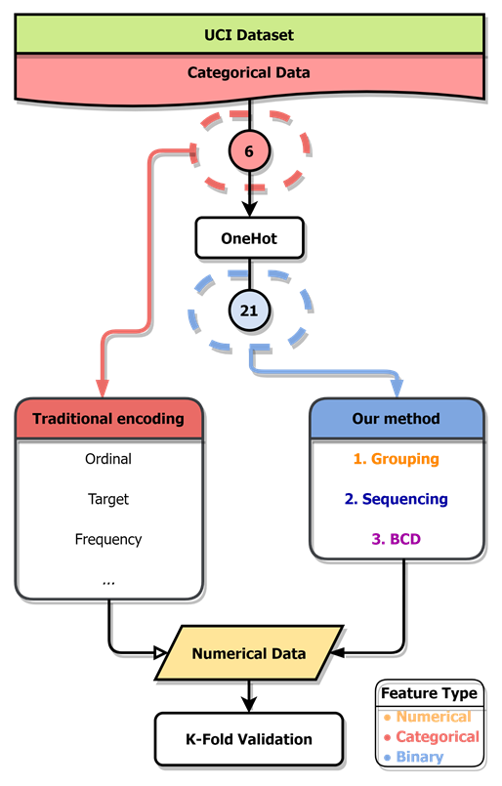
UCI dataset
Feature uniqueness of UCI car evaluation dataset
Price | Maintenance | Doors | Persons | Luggage boot | Safety | Evaluation
vhigh | vhigh | 2 | 2 | small | med | Acceptable
high | high | 3 | 4 | med | high | Unacceptable
med | med | 4 | more | big | low
low | low | 5more
Notes:
此6個類別變數經由OneHot encoding轉換之後，將產生21個二元變數，
以作為本研究方法輸入，並與傳統變數編碼相比較

Slide 62
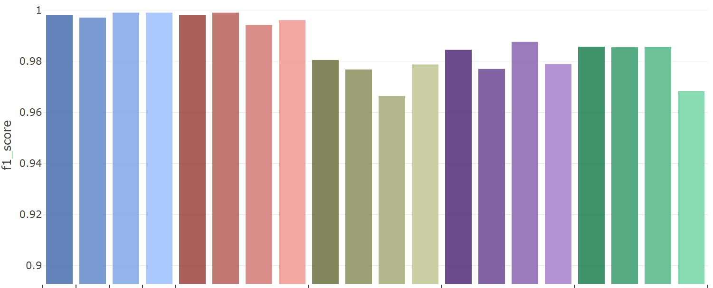
UCI dataset -Classification
Car Evaluations Dataset
 | One Hot | Binary | Ordinal | Target | Sum | Purity | FI | RND | Sum | Purity | FI | RND | Sum | Purity | FI | RND | Sum | Purity | FI | RND
 | Traditional |  |  |  | Default |  |  |  | Correlation |  |  |  | PCA |  |  |  | RND
 | 21 | 15 | 6
Notes:
可以看見傳統變數編碼方式、以及依照原先群組資訊而產生的數值資料集皆表現得相當優異，
甚至是單純的二元特徵資料即表現的相當不錯；反之，透過相關係數、主成分分析或隨機群組的方式皆造成分類成績的損失。
本研究推論此結果的原因有二：其一是此資料本身過於單純，且LightGBM在二十一個二元特徵之下仍能表現出不錯的分類能力，
當遭遇維度較低的二元資料問題時，使用本研究所發展之二元特徵編碼方式將無法有效用的使新數值資料的分類成績有大幅度的提升
其二則是群組方式仍需改進，根據相關係數、主成分分析的群組方式，皆無法達到根據原先的二元資料群組資訊相同的組分類平均，
而且也無法明顯的比隨機群組方式來的優越。

Slide 63
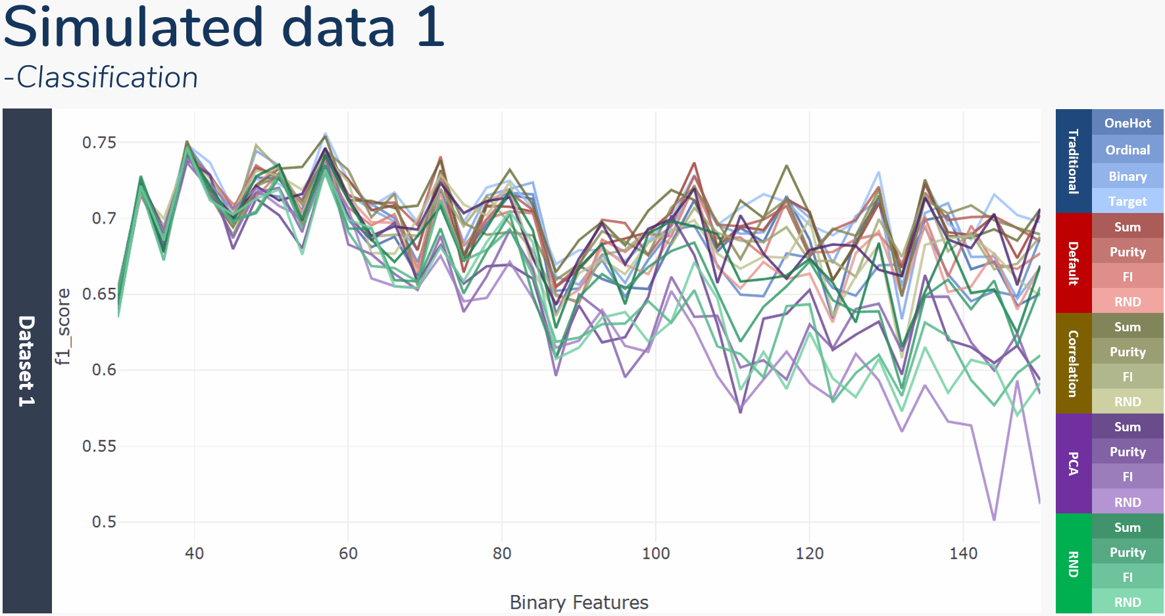
Notes:
在分類結果的評比中，將與OneHot, Binary, Ordinal, 與Target encoding等4種傳統的變數編碼比較
以及本研究四種群組方式，分別是根據原先群組資訊、主成分分析、皮爾森相關係數與隨機群組
結合4種排序方式，分別是特徵總和、類別純粹度、特徵重要性、與隨機排列
並以LightGBM梯度提升決策樹作為分類模型，且f1 score作為數值資料衡量標準
此折線圖則顯示了在切分出不同的二元特徵之下，各種方法k-folds驗證後的平均f1 score變化
觀察了此三張折線圖可見，在切分的二元變數數量較少時，所有變數編碼產生的數值資料有著相近的分類成績；
然而，隨著所切分的二元變數個數增加，變數編碼產生數值資料的分類成績之間的變異也逐漸增加、
且分類成績也有著緩步下降的趨勢，類似在維度災難發生時導致的模型成果下降。

Slide 64
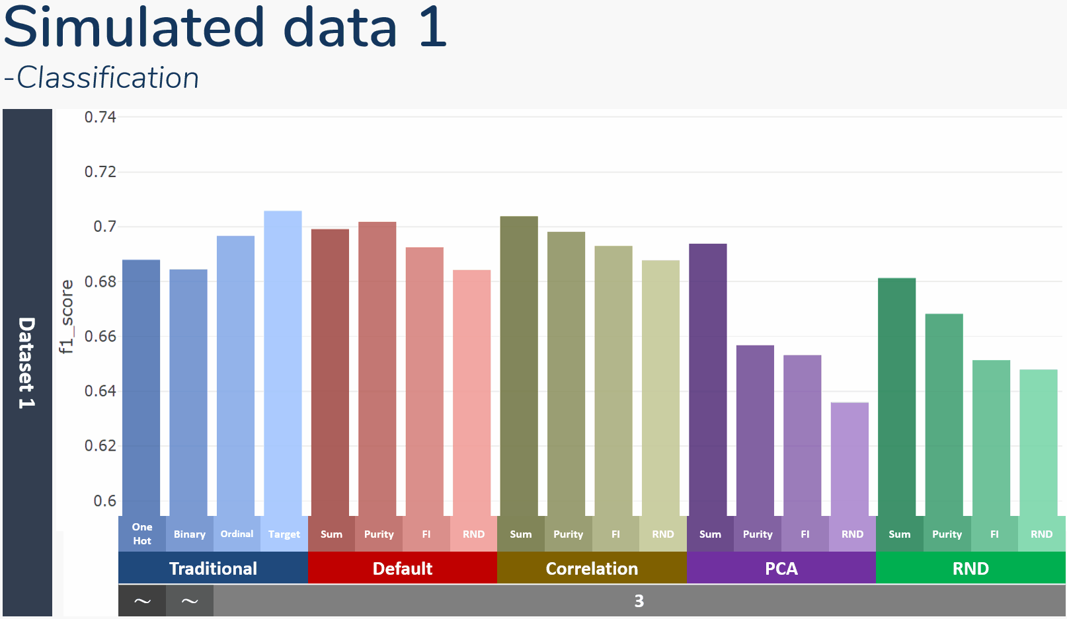
Simulated data 1 -Classification
Traditional | OneHot
 | Ordinal
 | Binary
 | Target
Default | Sum
 | Purity
 | FI
 | RND
Correlation | Sum
 | Purity
 | FI
 | RND
PCA | Sum
 | Purity
 | FI
 | RND
RND | Sum
 | Purity
 | FI
 | RND
Notes:
此直方圖則顯示了方才折線圖的平均成績，底下黑灰色欄位中則表示了該方法產生新數值資料的特徵個數
可以發現OneHot, Binary encoding的特徵各數是不固定的，OneHot 資料即為切分出的整體二元特徵
而Binary encoding使用特徵數將少於全數二元特徵個數
其中值得注意的以隨機排序的方式，其皆產出群組中最低的分類成績，表示排序對於編碼後數值資料的分類成果具有一定影響
以及由不同群組方式產生的數值資料有著不盡相同的平均成績，不論根據何種方式排序組內特徵，分類成績仍部分受到群組方式的影響
由於屬於監督式的變數編碼，目標編碼的表現相當出眾，在傳統編碼中能持續獲得最好的成績

Slide 65

Simulated data 1 -Classification
Dataset 1
 | One Hot | Binary | Ordinal | Target | Sum | Purity | FI | RND | Sum | Purity | FI | RND | Sum | Purity | FI | RND | Sum | Purity | FI | RND
 | Traditional |  |  |  | Default |  |  |  | Correlation |  |  |  | PCA |  |  |  | RND
 | ～ | ～ | 3
Notes:
此直方圖則顯示了方才折線圖的平均成績，底下黑灰色欄位中則表示了該方法產生新數值資料的特徵個數
可以發現OneHot, Binary encoding的特徵各數是不固定的，OneHot 資料即為切分出的整體二元特徵
而Binary encoding使用特徵數將少於全數二元特徵個數
其中值得注意的有RND排序方式，其皆產出群組中最低的分類成績
且Target encoding皆聚有不俗表現，因為其本身即屬於一種監度式的變數編碼方式

Slide 66


Simulated data 2 -Classification
Dataset 2
 | One Hot | Binary | Ordinal | Target | Sum | Purity | FI | RND | Sum | Purity | FI | RND | Sum | Purity | FI | RND | Sum | Purity | FI | RND
 | Traditional |  |  |  | Default |  |  |  | Correlation |  |  |  | PCA |  |  |  | RND
 | ～ | ～ | 3
Notes:
此為連續資料集二中不同方法的成績平均，依然可見RND排序方法於各群組方式中墊底
且Target encoding皆聚有不俗表現，因為其本身即屬於一種監度式的變數編碼方式
所以其分類成績皆優於其餘的變數編碼方式

Slide 67

Simulated data 3 -Classification
Dataset 3
 | One Hot | Binary | Ordinal | Target | Sum | Purity | FI | RND | Sum | Purity | FI | RND | Sum | Purity | FI | RND | Sum | Purity | FI | RND
 | Traditional |  |  |  | Default |  |  |  | Correlation |  |  |  | PCA |  |  |  | RND
 | ～ | ～ | 3
Notes:
此為連續資料集三中不同方法的成績平均，
由原始連續圖形中可見，本資料集兩種類別區分容易，本身便易於區分
相較前兩個資料集有著較高的分類成績

Slide 68

Simulated data 1 -Classification
Dataset 1
Traditional | OneHot
 | Ordinal
 | Binary
 | Target
Default | Sum
 | Purity
 | FI
 | RND
Correlation | Sum
 | Purity
 | FI
 | RND
PCA | Sum
 | Purity
 | FI
 | RND
RND | Sum
 | Purity
 | FI
 | RND
Notes:
在分類結果的評比中，與OneHot, Binary, Ordinal, 與Target encoding等4種傳統的變數編碼比較
以及本研究四種群組方式，分別是根據原先群組資訊、主成分分析、皮爾森相關係數與隨機群組
結合4種排序方式，分別是特徵總和、類別純粹度、特徵重要性、與隨機排列
並以LightGBM梯度提升決策樹作為分類模型，且f1 score作為數值資料衡量標準
此折線圖則顯示了在切分出不同的二元特徵之下，各種方法k-folds驗證後的平均f1 score變化

Slide 69

Simulated data 2 -Classification
Dataset 2
Traditional | OneHot
 | Ordinal
 | Binary
 | Target
Default | Sum
 | Purity
 | FI
 | RND
Correlation | Sum
 | Purity
 | FI
 | RND
PCA | Sum
 | Purity
 | FI
 | RND
RND | Sum
 | Purity
 | FI
 | RND
Notes:
此為連續資料集二於不同二元特徵個數下的分類成績折線

Slide 70

Simulated data 3 -Classification
Dataset 3
Traditional | OneHot
 | Ordinal
 | Binary
 | Target
Default | Sum
 | Purity
 | FI
 | RND
Correlation | Sum
 | Purity
 | FI
 | RND
PCA | Sum
 | Purity
 | FI
 | RND
RND | Sum
 | Purity
 | FI
 | RND
Notes:
此為連續資料集三於不同二元特徵個數下的分類成績折線，
觀察了先前的折線圖可見，在切分的二元變數數量較少時，所有變數編碼產生的數值資料有著相近的分類成績；
然而，隨著所切分的二元變數個數增加，變數編碼產生數值資料的分類成績之間的變異也逐漸增加、
且分類成績也有著緩步下降的趨勢，類似在維度災難發生時導致的模型成果下降。

Slide 71



UCI dataset -Group by hierarchical clustering
Notes:
此處則改以階層聚類結合相關係數進行特徵群組，根據特徵之間的相關性，
找出獨熱編碼後產生的二元特徵之間互斥關係，並還原出原始的群組資訊。
此方法群組結果將與根據原始群組資訊群組有著完全相同輸出
可將其作為一種還原二元資料特徵群組資訊的方式
但作為本研究所預想的群組方式乃是著重在於藉由結合、群聚由不同類別特徵所產生的二元特徵，
以融合出更具有分類價值與資料特性的新數值特徵，
而此方法與依據原始群組資訊所產生特徵群組完全相同，
因此並未加入群組方法中與其餘方式做比較。

Slide 72
Methodology -Sequencing
Group
Sequence
BCD
Grouped by PCA | Sequenced by column sum
Notes:
此為依據PCA群組，再以特徵總合重新排序組內特徵的成果

Slide 73


Kaggle dataset -Feature importance changes

Slide 74


Methodology - BCD encode
However, mostly the original binary data is sparse, not every 8421BCD scenario will appear. And if there are $k$ features in one group, the range of BCD encoded data will within $\left\{F_{j}^{n}∈ℝ | 0≤F_{j}^{n}<2^{k}−1\right\}$.
This cause the encoded data expand in range when $k$ is large, making both Euclidean distance calculation complicated and the sparsity between samples. A simple way to solve it is replace the BCD code with its ranking within the new feature.
Sorted
BCD
Ranked
Notes:
別別別

Slide 75

Methodology - BCD encode
Sorted
BCD
Ranked

Slide 76

Simulated data - seq. by sum
Sequence by column sum | BCD
Notes:
These is a demonstration of PCA grouping before sequenced by column sum.
in each PC we can see columns from different axis, and also, compare PC1 to PC5, PC5 only has small size binary features. Meaning binary features in PC1 has more samples can explain more variance to the whole data.
The BCD result is reasonable too, the informative seems dwindling by PCs.

Slide 77


Simulated data - group by PCA
Binarize Data | Grouped by PCA

Slide 78

Continuous data - group by Corr.
Original Group | Grouped by Correlation

Slide 79

Simulated data - seq. by impurity
Sequence by impurity | BCD encoded

Slide 80


Simulated data - seq. comparison
 | Sequenced | BCD
Randomly
By Impurity

Slide 81
Animal |  |  |  |  |  |  |  | Size |  |  |  | Color
Tuna | Cat | Frog | Cod | Goat | Dog | Toad | Cow | Large | Mid | Small | Tiny | White | Black | Red | Blue | Green | Gray
0 | 0 | 0 | 0 | 0 | 0 | 0 | 1 | 1 | 0 | 0 | 0 | 1 | 0 | 0 | 0 | 0 | 0
1 | 0 | 0 | 0 | 0 | 0 | 0 | 0 | 0 | 1 | 0 | 0 | 0 | 1 | 0 | 0 | 0 | 0
⁝ | ⁝ | ⁝ | ⁝ | ⁝ | ⁝ | ⁝ | ⁝ | ⁝ | ⁝ | ⁝ | ⁝ | ⁝ | ⁝ | ⁝ | ⁝ | ⁝ | ⁝
0 | 0 | 1 | 0 | 0 | 0 | 0 | 1 | 0 | 0 | 0 | 1 | 0 | 0 | 0 | 0 | 1 | 0
No. | PC 1 |  |  | PC 2 |  |  | PC 3
 | Feature | Abs. weight | select | Feature | Abs. weight | select | Feature | Abs. weight | select
1. | Cow | 0.562 | O | Cat | 0.642 | X | Black | 0.047 | X
2. | Cat | 0.486 | O | Cow | 0.496 | X | Goat | 0.035 | X
3. | Large | 0.348 | O | Mid | 0.402 | X | Cat | 0.032 | X
4. | Mid | 0.311 | O | Black | 0.351 | X | Cow | 0.030 | X
5. | White | 0.307 | O | Goat | 0.302 | O | Mid | 0.028 | X
6. | Black | 0.202 | O | Dog | 0.229 | O | Gray | 0.023 | X
7. | Small | 0.187 | X | Large | 0.199 | X | White | 0.021 | X
8. | Goat | 0.153 | X | Frog | 0.183 | O | Dog | 0.020 | X
9. | Cod | 0.101 | X | Small | 0.152 | O | Large | 0.018 | X
10. | Tuna | 0.091 | X | Gray | 0.132 | O | Frog | 0.016 | X
11. | Dog | 0.074 | X | White | 0.105 | X | Small | 0.014 | X
12. | Gray | 0.060 | X | Red | 0.008 | O | Toad | 0.014 | O
13. | Frog | 0.056 | X | Frog | 0.008 | X | Tuna | 0.012 | O
14. | Toad | 0.032 | X | Red | 0.007 | X | Cod | 0.007 | O
15. | Red | 0.029 | X | Toad | 0.005 | X | Red | 0.005 | X
16. | Tiny | 0.023 | X | Green | 0.001 | X | Tiny | 0.002 | O
17. | Green | 0.015 | X | Tiny | 0.001 | X | Blue | 0.001 | O
18. | Blue | 0.009 | X | Blue | 0.001 | X | Green | 0.001 | O
PC 1 |  |  |  |  |  | PC 2 |  |  |  |  |  | PC 3
Cow | Cat | Large | Mid | White | Black | Goat | Dog | Frog | Small | Gray | Red | Toad | Tuna | Cod | Tiny | Blue | Green
1 | 0 | 1 | 0 | 1 | 0 | 0 | 0 | 0 | 0 | 0 | 0 | 0 | 0 | 0 | 0 | 0 | 0
0 | 0 | 0 | 1 | 0 | 1 | 0 | 0 | 0 | 0 | 0 | 0 | 0 | 1 | 0 | 0 | 0 | 0
⁝ | ⁝ | ⁝ | ⁝ | ⁝ | ⁝ | ⁝ | ⁝ | ⁝ | ⁝ | ⁝ | ⁝ | ⁝ | ⁝ | ⁝ | ⁝ | ⁝ | ⁝
1 | 0 | 0 | 0 | 0 | 0 | 0 | 0 | 1 | 0 | 0 | 0 | 0 | 0 | 0 | 1 | 0 | 1
Tuna | Cat | Frog | Cod | Goat | Dog | Toad | Cow | Large | Mid | Small | Tiny | White | Black | Red | Blue | Green | Gray
0 | 0 | 0 | 0 | 0 | 0 | 0 | 1 | 1 | 0 | 0 | 0 | 1 | 0 | 0 | 0 | 0 | 0
1 | 0 | 0 | 0 | 0 | 0 | 0 | 0 | 0 | 1 | 0 | 0 | 0 | 1 | 0 | 0 | 0 | 0
⁝ | ⁝ | ⁝ | ⁝ | ⁝ | ⁝ | ⁝ | ⁝ | ⁝ | ⁝ | ⁝ | ⁝ | ⁝ | ⁝ | ⁝ | ⁝ | ⁝ | ⁝
0 | 0 | 1 | 0 | 0 | 0 | 0 | 1 | 0 | 0 | 0 | 1 | 0 | 0 | 0 | 0 | 1 | 0

Slide 82
Corr 1 |  |  |  |  |  | Corr 2 |  |  |  |  |  | Corr 3
Cow | Cat | Large | Mid | White | Black | Goat | Dog | Frog | Small | Gray | Red | Toad | Tuna | Cod | Tiny | Blue | Green
1 | 0 | 1 | 0 | 1 | 0 | 0 | 0 | 0 | 0 | 0 | 0 | 0 | 0 | 0 | 0 | 0 | 0
0 | 0 | 0 | 1 | 0 | 1 | 0 | 0 | 0 | 0 | 0 | 0 | 0 | 1 | 0 | 0 | 0 | 0
⁝ | ⁝ | ⁝ | ⁝ | ⁝ | ⁝ | ⁝ | ⁝ | ⁝ | ⁝ | ⁝ | ⁝ | ⁝ | ⁝ | ⁝ | ⁝ | ⁝ | ⁝
1 | 0 | 0 | 0 | 0 | 0 | 0 | 0 | 1 | 0 | 0 | 0 | 0 | 0 | 0 | 1 | 0 | 1
 | Tuna | Cat | Frog | Cod | Goat | Dog | Toad | Cow | Large | Mid | Small | Tiny | White | Black | Red | Blue | Green | Gray
Tuna | 1.0 | 0.2 | 0.2 | 0.8 | 0.2 | 0.2 | 0.8 | 0.2 | 0.1 | 0.1 | 0.1 | 0.3 | 0.0 | 0.0 | 0.0 | 0.5 | 0.5 | 0.0
Cat | 0.2 | 1.0 | 0.2 | 0.2 | 0.2 | 0.2 | 0.2 | 0.8 | 0.3 | 0.3 | 0.1 | 0.1 | 0.2 | 0.2 | 0.0 | 0.0 | 0.0 | 0.0
Frog | 0.2 | 0.2 | 1.0 | 0.2 | 0.8 | 0.8 | 0.2 | 0.2 | 0.1 | 0.1 | 0.3 | 0.1 | 0.0 | 0.0 | 0.3 | 0.0 | 0.0 | 0.3
Cod | 0.8 | 0.2 | 0.2 | 1.0 | 0.2 | 0.2 | 0.8 | 0.8 | 0.1 | 0.1 | 0.1 | 0.3 | 0.0 | 0.0 | 0.0 | 0.3 | 0.3 | 0.0
Goat | 0.2 | 0.2 | 0.8 | 0.2 | 1.0 | 0.8 | 0.2 | 0.2 | 0.1 | 0.1 | 0.3 | 0.1 | 0.0 | 0.0 | 0.3 | 0.0 | 0.0 | 0.3
Dog | 0.2 | 0.2 | 0.8 | 0.2 | 0.8 | 1.0 | 0.2 | 0.2 | 0.1 | 0.1 | 0.3 | 0.1 | 0.0 | 0.0 | 0.3 | 0.0 | 0.0 | 0.3
Toad | 0.8 | 0.2 | 0.2 | 0.8 | 0.2 | 0.2 | 1.0 | 0.2 | 0.1 | 0.1 | 0.1 | 0.3 | 0.0 | 0.0 | 0.0 | 0.3 | 0.0 | 0.0
Cow | 0.2 | 0.8 | 0.2 | 0.8 | 0.2 | 0.2 | 0.2 | 1.0 | 0.3 | 0.3 | 0.1 | 0.1 | 0.3 | 0.3 | 0.0 | 0.0 | 0.0 | 0.0
Large | 0.1 | 0.3 | 0.1 | 0.1 | 0.1 | 0.1 | 0.1 | 0.3 | 1.0 | 0.5 | 0.1 | 0.1 | 0.6 | 0.6 | 0.2 | 0.2 | 0.2 | 0.2
Mid | 0.1 | 0.3 | 0.1 | 0.1 | 0.1 | 0.1 | 0.1 | 0.3 | 0.5 | 1.0 | 0.1 | 0.1 | 0.6 | 0.6 | 0.2 | 0.2 | 0.2 | 0.2
Small | 0.1 | 0.1 | 0.3 | 0.1 | 0.3 | 0.3 | 0.1 | 0.1 | 0.1 | 0.1 | 1.0 | 0.1 | 0.2 | 0.2 | 0.6 | 0.2 | 0.2 | 0.6
Tiny | 0.3 | 0.1 | 0.1 | 0.3 | 0.1 | 0.1 | 0.3 | 0.1 | 0.1 | 0.1 | 0.1 | 1.0 | 0.2 | 0.2 | 0.2 | 0.6 | 0.2 | 0.2
White | 0.0 | 0.2 | 0.0 | 0.0 | 0.0 | 0.0 | 0.0 | 0.3 | 0.6 | 0.6 | 0.2 | 0.2 | 1.0 | 0.8 | 0.4 | 0.4 | 0.4 | 0.4
Black | 0.0 | 0.2 | 0.0 | 0.0 | 0.0 | 0.0 | 0.0 | 0.3 | 0.6 | 0.6 | 0.2 | 0.2 | 0.8 | 1.0 | 0.4 | 0.4 | 0.4 | 0.8
Red | 0.0 | 0.0 | 0.3 | 0.0 | 0.3 | 0.3 | 0.0 | 0.0 | 0.2 | 0.2 | 0.6 | 0.2 | 0.4 | 0.4 | 1.0 | 0.4 | 0.4 | 0.4
Blue | 0.5 | 0.0 | 0.0 | 0.3 | 0.0 | 0.0 | 0.3 | 0.0 | 0.2 | 0.2 | 0.2 | 0.6 | 0.4 | 0.4 | 0.4 | 1.0 | 0.8 | 0.8
Green | 0.5 | 0.0 | 0.0 | 0.3 | 0.0 | 0.0 | 0.0 | 0.0 | 0.2 | 0.2 | 0.2 | 0.2 | 0.4 | 0.4 | 0.4 | 0.8 | 1.0 | 0.4
Gray | 0.0 | 0.0 | 0.3 | 0.0 | 0.3 | 0.3 | 0.0 | 0.0 | 0.2 | 0.2 | 0.6 | 0.2 | 0.4 | 0.8 | 0.4 | 0.8 | 0.4 | 1.0
 | Cow | Cat | Large | Mid | White | Black | Goat | Dog | Frog | Small | Gray | Red | Toad | Tuna | Cod | Tiny | Blue | Green
Cow | 1.0 | 0.8 | 0.3 | 0.3 | 0.5 | 0.5 | 0.2 | 0.2 | 0.2 | 0.1 | 0.0 | 0.0 | 0.2 | 0.2 | 0.2 | 0.1 | 0.0 | 0.0
Cat | 0.8 | 1.0 | 0.3 | 0.3 | 0.5 | 0.5 | 0.2 | 0.2 | 0.2 | 0.1 | 0.0 | 0.0 | 0.2 | 0.2 | 0.2 | 0.1 | 0.0 | 0.0
Large | 0.3 | 0.3 | 1.0 | 0.5 | 0.6 | 0.6 | 0.1 | 0.1 | 0.1 | 0.1 | 0.2 | 0.2 | 0.1 | 0.1 | 0.1 | 0.1 | 0.2 | 0.2
Mid | 0.3 | 0.3 | 0.5 | 1.0 | 0.6 | 0.6 | 0.1 | 0.1 | 0.1 | 0.1 | 0.2 | 0.2 | 0.1 | 0.1 | 0.1 | 0.1 | 0.2 | 0.2
White | 0.5 | 0.5 | 0.6 | 0.6 | 1.0 | 0.8 | 0.0 | 0.0 | 0.0 | 0.2 | 0.4 | 0.4 | 0.0 | 0.0 | 0.0 | 0.2 | 0.4 | 0.4
Black | 0.5 | 0.5 | 0.6 | 0.6 | 0.8 | 1.0 | 0.0 | 0.0 | 0.0 | 0.2 | 0.4 | 0.4 | 0.0 | 0.0 | 0.0 | 0.2 | 0.4 | 0.4
Goat | 0.2 | 0.2 | 0.1 | 0.1 | 0.0 | 0.0 | 1.0 | 0.8 | 0.8 | 0.3 | 0.3 | 0.3 | 0.2 | 0.2 | 0.2 | 0.1 | 0.0 | 0.0
Dog | 0.2 | 0.2 | 0.1 | 0.1 | 0.0 | 0.0 | 0.8 | 1.0 | 0.8 | 0.3 | 0.5 | 0.5 | 0.2 | 0.2 | 0.2 | 0.1 | 0.0 | 0.0
Frog | 0.2 | 0.2 | 0.1 | 0.1 | 0.0 | 0.0 | 0.8 | 0.8 | 1.0 | 0.3 | 0.5 | 0.5 | 0.2 | 0.2 | 0.2 | 0.1 | 0.0 | 0.0
Small | 0.1 | 0.1 | 0.1 | 0.1 | 0.2 | 0.2 | 0.3 | 0.3 | 0.3 | 1.0 | 0.6 | 0.6 | 0.1 | 0.1 | 0.1 | 0.1 | 0.2 | 0.2
Gray | 0.0 | 0.0 | 0.2 | 0.2 | 0.4 | 0.4 | 0.3 | 0.5 | 0.5 | 0.6 | 1.0 | 0.8 | 0.0 | 0.0 | 0.0 | 0.2 | 0.4 | 0.4
Red | 0.0 | 0.0 | 0.2 | 0.2 | 0.4 | 0.4 | 0.3 | 0.5 | 0.5 | 0.6 | 0.8 | 1.0 | 0.0 | 0.0 | 0.0 | 0.2 | 0.4 | 0.4
Toad | 0.2 | 0.2 | 0.1 | 0.1 | 0.0 | 0.0 | 0.2 | 0.2 | 0.2 | 0.1 | 0.0 | 0.0 | 1.0 | 0.8 | 0.8 | 0.3 | 0.5 | 0.5
Tuna | 0.2 | 0.2 | 0.1 | 0.1 | 0.0 | 0.0 | 0.2 | 0.2 | 0.2 | 0.1 | 0.0 | 0.0 | 0.8 | 1.0 | 0.8 | 0.3 | 0.5 | 0.5
Cod | 0.2 | 0.2 | 0.1 | 0.1 | 0.0 | 0.0 | 0.2 | 0.2 | 0.2 | 0.1 | 0.0 | 0.0 | 0.8 | 0.8 | 1.0 | 0.3 | 0.5 | 0.5
Tiny | 0.1 | 0.1 | 0.1 | 0.1 | 0.2 | 0.2 | 0.1 | 0.1 | 0.1 | 0.1 | 0.2 | 0.2 | 0.3 | 0.3 | 0.3 | 1.0 | 0.6 | 0.6
Blue | 0.0 | 0.0 | 0.2 | 0.2 | 0.4 | 0.4 | 0.0 | 0.0 | 0.0 | 0.2 | 0.4 | 0.4 | 0.5 | 0.5 | 0.5 | 0.6 | 1.0 | 0.8
Green | 0.0 | 0.0 | 0.2 | 0.2 | 0.4 | 0.4 | 0.0 | 0.0 | 0.0 | 0.2 | 0.4 | 0.4 | 0.5 | 0.5 | 0.5 | 0.6 | 0.8 | 1.0

Slide 86


Slide 87
 | Sequenced Column Group |  |  |  |  |  | BCD | Type
 | Blue | Tuna | Tiny | Toad | Green | Cod
Sample 1 | 1 | 0 | 0 | 0 | 0 | 1 | 33 | Good
Sample 2 | 1 | 0 | 0 | 1 | 0 | 0 | 36 | Good
Sample 3 | 0 | 0 | 1 | 0 | 1 | 0 | 10 | Bad
Sample 4 | 0 | 0 | 1 | 1 | 1 | 0 | 14 | Bad
⁝ | ⁝ | ⁝ | ⁝ | ⁝ | ⁝ | ⁝ | ⁝ | ⁝

Slide 88



Instances | X | Y | Z
1 | x.2 | y.9 | z.4
2 | x.1 | y.8 | z.2
3 | x.9 | y.1 | z.6
4 | x.5 | y.7 | z.8
5 | x.3 | y.1 | z.8
6 | x.5 | y.6 | z.3
7 | x.7 | y.5 | z.4
⁝ | ⁝ | ⁝ | ⁝
3300 | x.4 | y.8 | z.1
Instances | x.1 | x.2 | x.3 | x.4 | x.5 | x.6 | … | z.9 | z.10
1 | 0 | 1 | 0 | 0 | 0 | 0 | … | 0 | 0
2 | 1 | 0 | 0 | 0 | 0 | 0 | … | 0 | 0
3 | 0 | 0 | 0 | 0 | 0 | 0 | … | 0 | 0
4 | 0 | 0 | 0 | 0 | 1 | 0 | … | 0 | 0
5 | 0 | 0 | 1 | 0 | 0 | 0 | … | 0 | 0
6 | 0 | 0 | 0 | 0 | 1 | 0 | … | 0 | 0
7 | 0 | 0 | 0 | 0 | 0 | 0 | … | 0 | 0
⁝ | ⁝ | ⁝ | ⁝ | ⁝ | ⁝ | ⁝ | ⁝ | ⁝ | ⁝
3300 | 0 | 0 | 0 | 1 | 0 | 0 | … | 0 | 0

Slide 89



Traditional | OneHot
 | Ordinal
 | Binary
 | Target
Default | Sum
 | Purity
 | FI
 | RND
Correlation | Sum
 | Purity
 | FI
 | RND
PCA | Sum
 | Purity
 | FI
 | RND
RND | Sum
 | Purity
 | FI
 | RND
 | One Hot | Binary | Ordinal | Target | Purity | Purity
 | Traditional |  |  |  | Default | PCA
 | 83 | 38 | 17 |  |  | 10 | 20 | 30
 | One Hot | Binary | Ordinal | Target | Sum | Purity | FI | RND | Sum | Purity | FI | RND | Sum | Purity | FI | RND | Sum | Purity | FI | RND
 | Traditional |  |  |  | Default |  |  |  | Correlation |  |  |  | PCA |  |  |  | RND
 | 21 | 15 | 6

Slide 90




Slide 91



By purity |  | Randomly
1 | Cluster | 24

Slide 92



Difference 3D Dimension Reduced Data After Encode With Certain Sequencing
Impurity | Randomly | Sum

Slide 93

 | Purity | Purity | Purity | Purity | Purity
 | PCA
 | 10 | 20 | 30 | 40 | 50
 | Purity | Purity | Purity | Purity | Purity
 | Corr
 | 10 | 20 | 30 | 40 | 50

